Slide 1
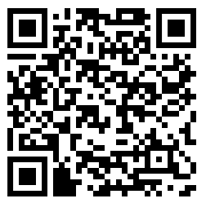
Choosing Genomics Tools
Organized by: Candace Savonen
Notes:
Title image: Choosing Genomics Tools Written by: Candace Savonen
Part of the ITN (ITCR training Network) and created through the Fred Hutch Data Science Lab

Slide 2
Licensing
Notes:
Except where otherwise indicated, The contents of this slide presentation are available for use under the Creative Commons Attribution 4.0 license. You are free to adapt and share the work, but you must give appropriate credit, provide a link to the license, and indicate if changes were made. Sample attribution: Documentation and Usability by Johns Hopkins Data Science Lab. CC-BY 4.0

Slide 3




For individuals who:
Have -omic data and don’t know what to do with it
Want a basic overview of their -omic data type
Want to find resources for processing and interpreting -omics data
Icons from Iconspack.net
Notes:
For individuals who: Have genomic data and don’t know what to do with it. Want a basic overview of their genomic data type. Want to find resources for processing and interpreting genomics data

Slide 4




Concepts discussed in Choosing -omics Tools course:
What does your genomic data type represent?
What are the most common data processing steps for your data type
Find resources, tools and tutorials to help you process and interpret your data
CC-BY
Notes:
Concepts discussed in Documentation and Usability course:Apply usability research concepts, Create user friendly guides, Document code clearly, Obtain helpful user feedback

Slide 5




Your data are ready.
Image by candace Savonen with Avataars and Openmoji.org
Notes:
This researcher is very excited because they’ve received their genomic data and are ready to gain insights from it to inform the next steps of their research. An email sent to them says ‘your data are ready’

Slide 6
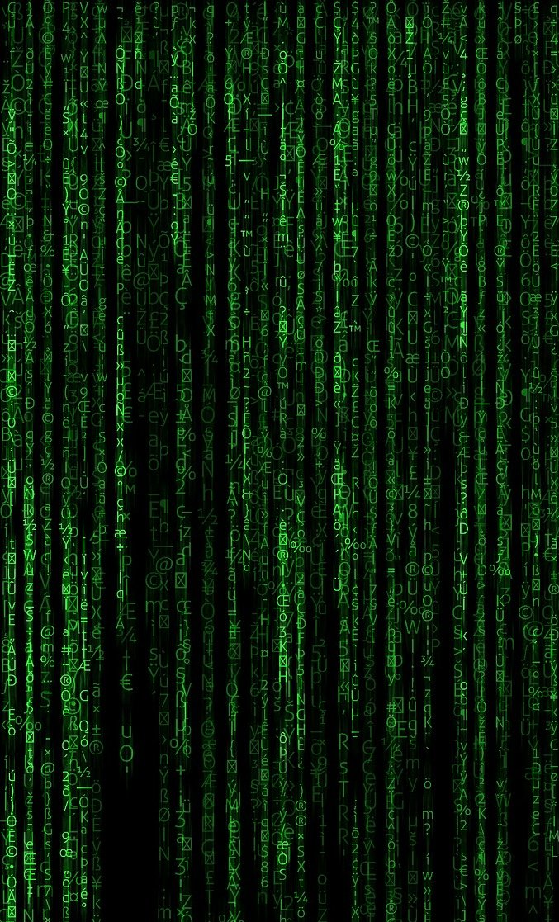


What is this and what do I do with it?
Genomic data
Image by Candace Savonen with Avataars, pixabay and openmoji.org
Notes:
The researcher may attempt to open their newly received genomic data and be completely perplexed by the file formats or what these data even represent. The researcher says ‘What is this and what do I do with it’

Slide 7
Overall Course Learning Objectives
This course will demonstrate how to:
Understand the overall workflow associated with processing their genomic data
Find tutorials to help them process their genomic data
Choose tools for processing and interpreting their genomic data
Notes:
Overall Course Learning Objectives. This course will demonstrate how too: Understand the overall workflow associated with processing their genomic data Be aware of caveats based on their specific type of data. Find tutorials to help them process their genomic data. Choose tools for processing their genomic data. Choose tools for interpreting their genomic data

Slide 8
Learning Objectives
This chapter will demonstrate how to:
Understand what will be covered in this course
Find information about your particular file format
Expect the general workflow of most omic data
Notes:
Learning objectives This chapter will demonstrate how to: Understand what will be covered in this course. Find information about your particular file format

Slide 9



Genomics workflows in a very general sense
Raw Data
Normalized Data
Summarized Data
Plots and Results!
Image by Candace Savonen using IconFinder
Notes:
In the most general sense, all genomics data when originally collected is raw, it needs to undergo processing to be normalized and ready to use. Then normalized data is generally summarized in a way that is ready for it to be further consumed. Lastly this summarized data is what can be used to make inferences and create plots and results tables.

Slide 10
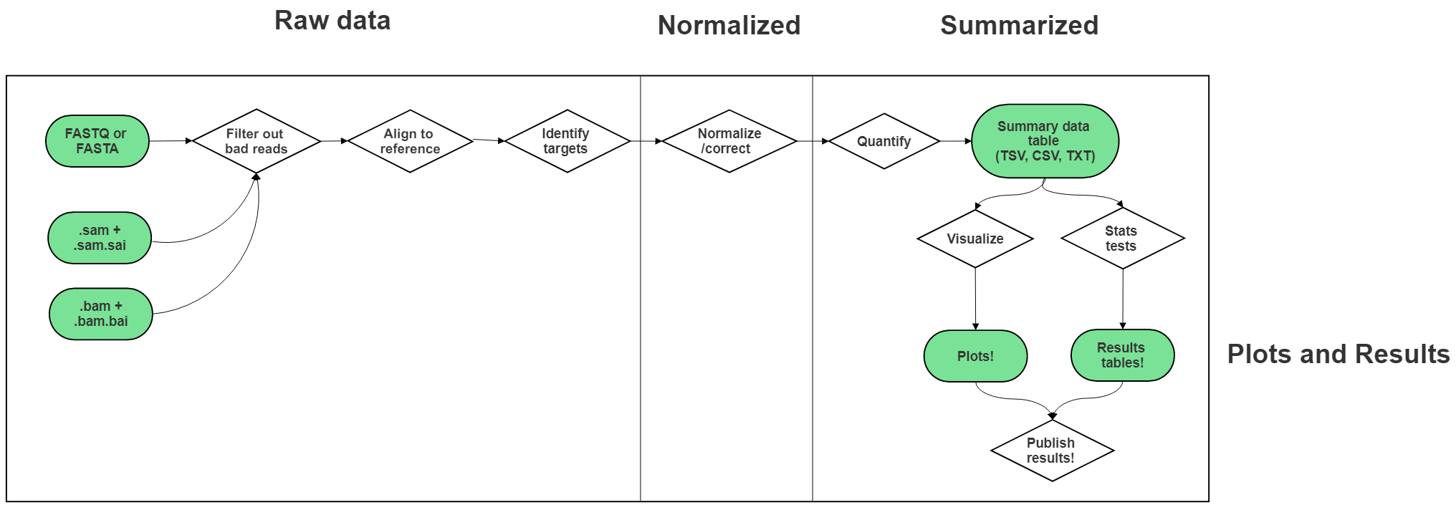
A very very general sequencing file format workflow
Image by Candace Savonen using SmartDraw

Slide 11
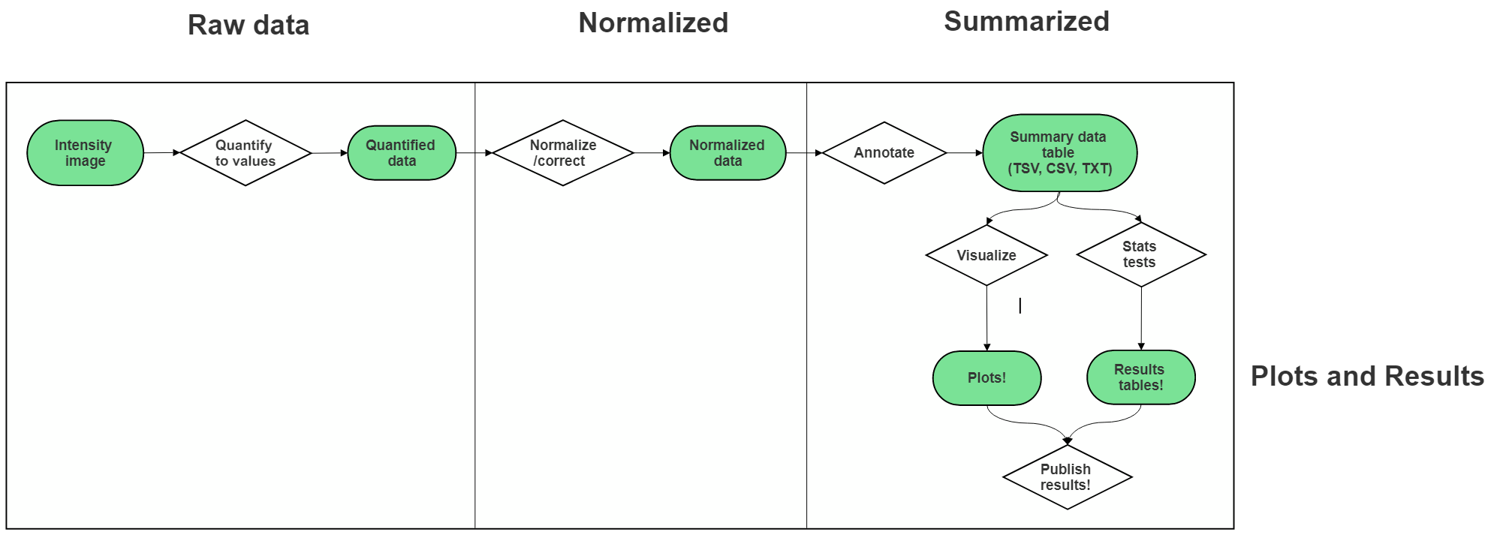
A very very general microarray file format workflow
Image by Candace Savonen using SmartDraw

Slide 12
Learning Objectives
This chapter will demonstrate how to:
Understand what metadata are and why they are so critical
Learn the basics of creating crystal clear, readable metadata
Notes:
Learning objectives This chapter will demonstrate how to: Understand what metadata are and why they are so critical. Learn the basics of creating crystal clear, readable metadata

Slide 13

Q: What are metadata?
A: Anything and everything that should be known about your samples!
I know everything I need to know about these samples from their metadata!
sample_id | mouse_id | processing_date | treatment | …
A | 1 | 3-10-21 | None | …
B | 1 | 4-12-21 | None | …
C | 2 | 3-10-21 | None | …
D | 2 | 4-12-21 | None | …
E | 3 | 3-10-21 | Morphine | …
F | 3 | 4-12-21 | Morphine | …
G | 4 | 3-10-21 | Morphine | …
H | 4 | 4-12-21 | Morphine | …
A B C D
E F G H
Notes:
Question: What are metadata? Answer: Anything and everything that should be known about your samples! Samples labeled A-H are in test tubes. A corresponding spreadsheet has metadata such as mouse id, processing date, treatment and etc. The researcher says ‘I know everything I need to know about these samples from their metadata!’

Slide 14
Examples of metadata categories:
Patient/organism of origin
Patient/organism information
Demographics
Disease state
Treatment state
Time point (if applicable)
Processing information
Batch information
Processing details (E.g. Isolation methods: Poly-A vs Ribo-minus)
Anything that should be known about the samples and their handling!
Notes:
Examples of metadata categories: Patient/organism of origin, Patient/organism information including: Demographics, Disease state, Treatment state, Time point (if applicable). Metadata also includes: Processing information like: Batch information and Processing details (for example: Isolation methods: Poly-A vs Ribo-minus) Metadata is Anything that should be known about the samples and their handling!

Slide 15
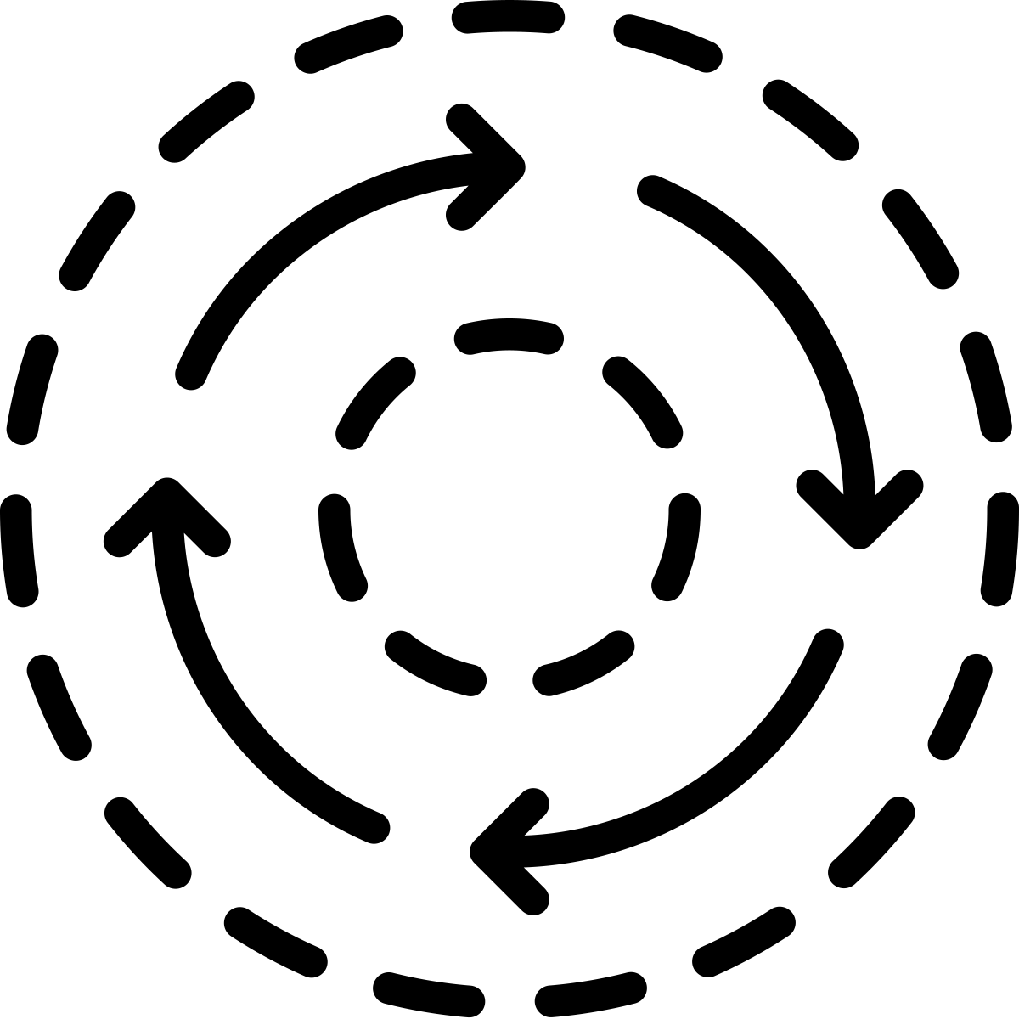





Rules for creating metadata (from Broman & Woo, 2017)
Be Consistent
Choose good names for things
Write Dates as YYYY-MM-DD
No Empty Cells
Put Just One Thing in a Cell
Make it a Rectangle
1
Notes:
Rules for creating metadata (from Broman & Woo, 2017) Be Consistent. Choose good names for things. Write Dates as YYYY-MM-DD.No Empty Cells. Put Just One Thing in a Cell. Make it a Rectangle

Slide 16



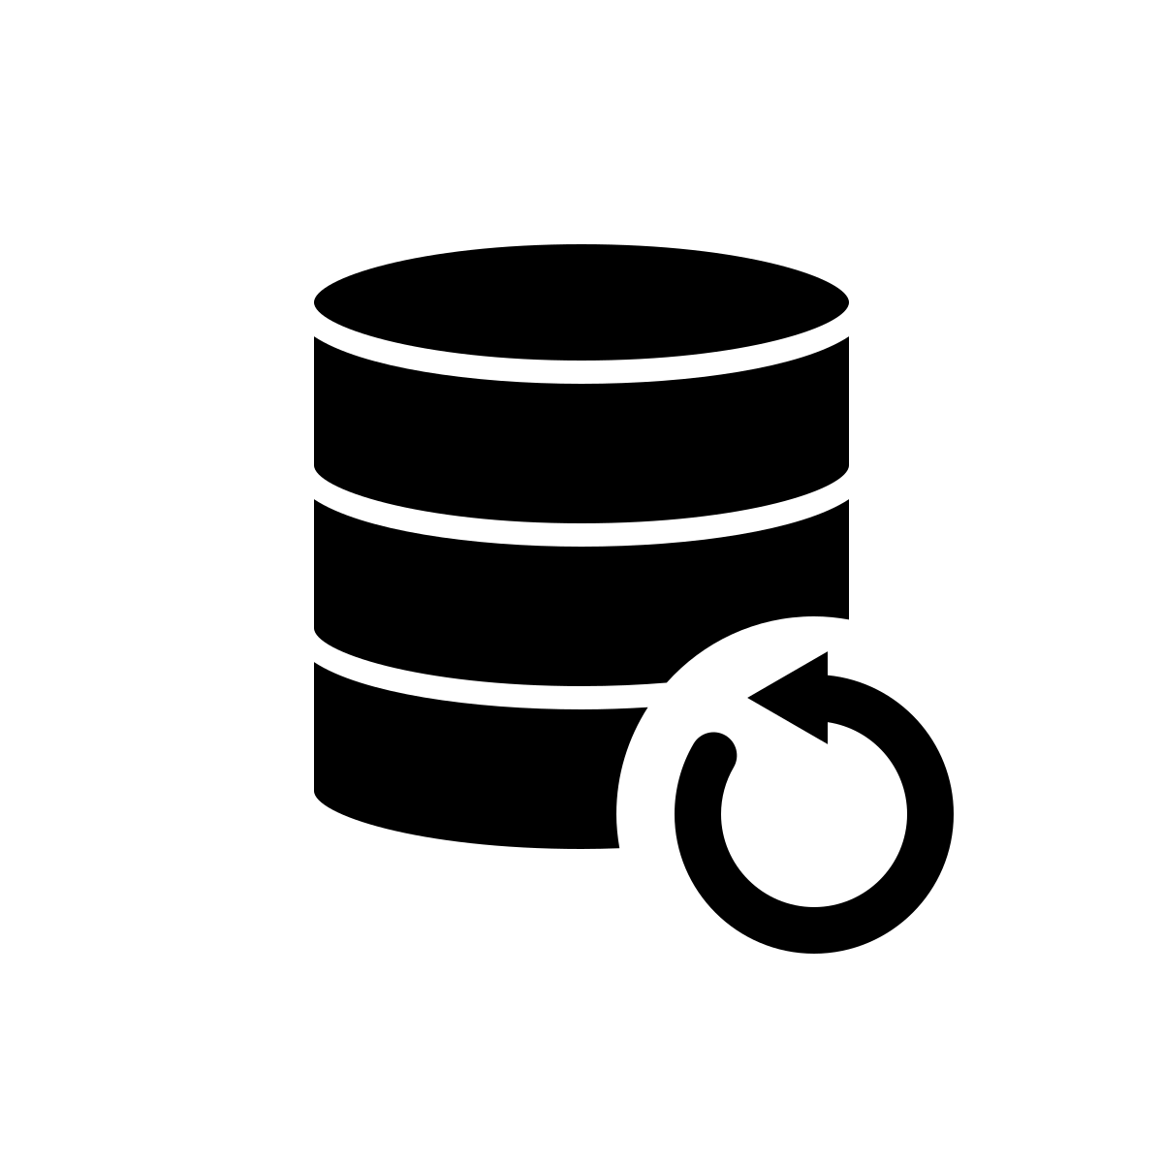

Rules for creating metadata continued (from Broman & Woo, 2017)
Create a Data Dictionary
No Calculations in the Raw Data Files
Do Not Use Font Color or Highlighting as Data
Make Backups
Use Data Validation to Avoid Errors
Notes:
Rules for creating metadata continued (from Broman & Woo, 2017). Create a Data Dictionary. No Calculations in the Raw Data Files. Do Not Use Font Color or Highlighting as Data. Make Backups. Use Data Validation to Avoid Errors

Slide 17
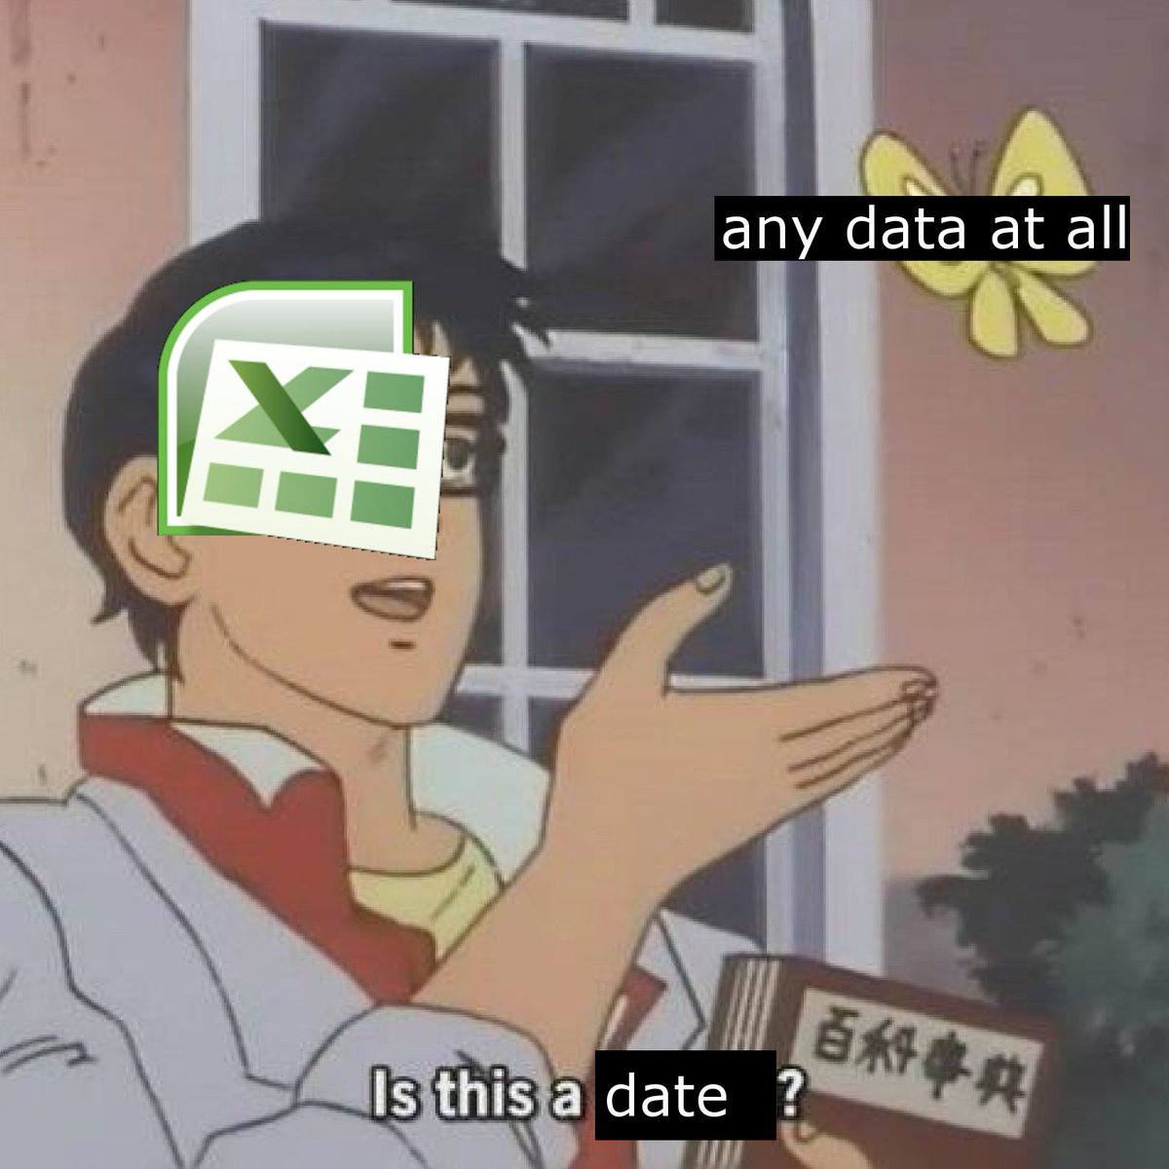
“Approximately one-fifth of papers with supplementary Excel gene lists contain erroneous gene name conversions”
Ziemann, Eren, El-Osta, 2016
From UFOtekkie’s twitter
Notes:
‘Approximately one-fifth of papers with supplementary Excel gene lists contain erroneous gene name conversions’ Ziemann, Eren, El-Osta, 2016 On the left, a meme that shows Excel asking ‘is this a date?’ in response to seeing ‘any data at all’.

Slide 18
Learning Objectives
This chapter will demonstrate how to:
Recognize the key aspects of a tool that you should consider when constructing an analysis
Form questions to ask others for advice regarding your data
Notes:
This chapter will demonstrate how to: Recognize the key aspects of a tool that you should consider when constructing an analysis. Form questions to ask others for advice regarding your data

Slide 19
Considerations for choosing tools:
Is it appropriate for your data type?
Is in an interface or programming language you feel comfortable with?
How much computing power do you have?
Are there benchmarking papers that compare the tool options?
Is the tool well documented and usable?
Is the tool well-maintained?
Is the tool generally accepted by the field?
Notes:
Considerations for choosing tools: Is it appropriate for your data type? Is in an interface or programming language you feel comfortable with? How much computing power do you have? Are there benchmarking papers that compare the tool options? Is the tool well documented and usable? Is the tool well-maintained? Is the tool generally accepted by the field?

Slide 20
Learning Objectives
This chapter will demonstrate how to:
Understand the difference between command line and GUI based applications
Understand what R and Python languages are
Find many links to resources where you can learn R or Python
Notes:
This chapter will demonstrate how to: Understand the difference between command line and GUI based applications. Understand what R and Python languages are. Find many links to resources where you can learn R or Python

Slide 21
Learning Objectives
This chapter will demonstrate how to:
Understand the fundamentals of annotating genomic data
Be aware of how reference genomes and their versions affect annotation
Be able to find genomic annotation from the respective databases
Notes:
This chapter will demonstrate how to: Understand the basics of bisulfite sequencing data collection and processing workflow. Identify the next steps for your particular bisulfite sequencing data. Formulate questions to ask about your bisulfite sequencing data

Slide 22
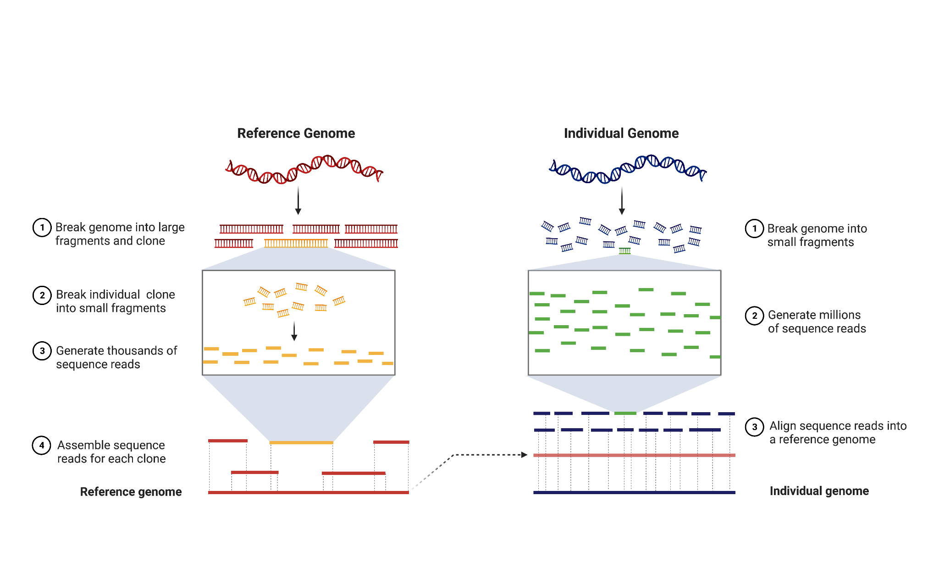
Reference genomes
Made with Biorender
Notes:
This chapter will demonstrate how to: Understand the basics of bisulfite sequencing data collection and processing workflow. Identify the next steps for your particular bisulfite sequencing data. Formulate questions to ask about your bisulfite sequencing data

Slide 23
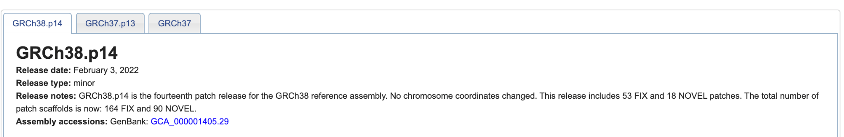
Genome versions
Different version names (for human)
From the Genome Reference Consortium
https://www.ncbi.nlm.nih.gov/grc/human
Notes:
This chapter will demonstrate how to: Understand the basics of bisulfite sequencing data collection and processing workflow. Identify the next steps for your particular bisulfite sequencing data. Formulate questions to ask about your bisulfite sequencing data

Slide 24
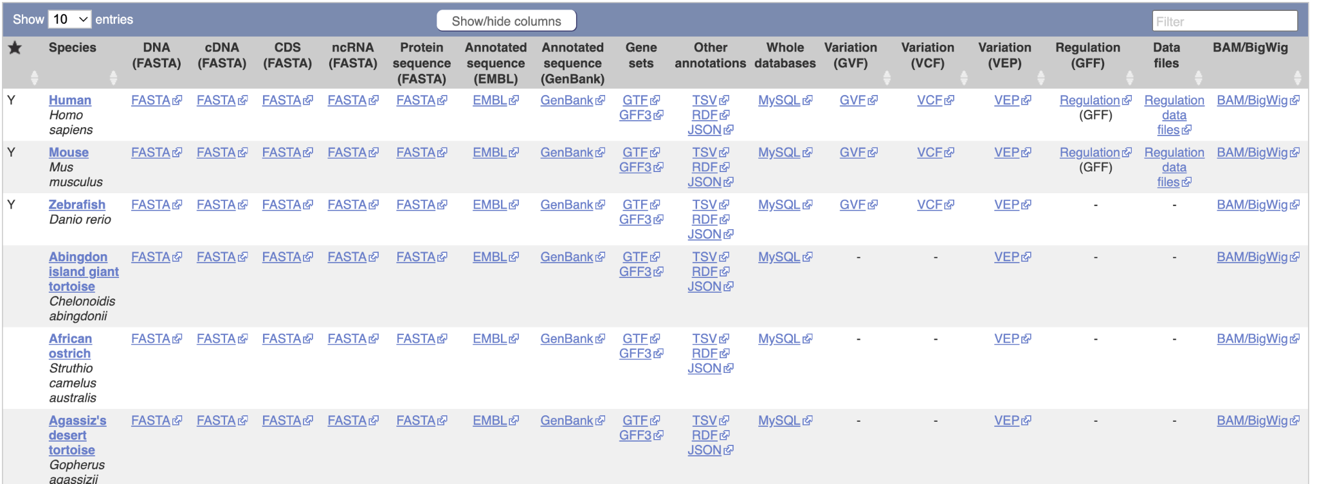
What data file do I need?
Notes:
This chapter will demonstrate how to: Understand the basics of bisulfite sequencing data collection and processing workflow. Identify the next steps for your particular bisulfite sequencing data. Formulate questions to ask about your bisulfite sequencing data

Slide 25
Learning Objectives
This chapter will demonstrate how to:
Understand the very general basics of microarray data collection.
Understand the limitations and strengths of microarray data in general.
Notes:
This chapter will demonstrate how to: Understand the very general basics of microarray data collection and processing workflow. Understand the limitations and strengths of microarray data in general.

Slide 26
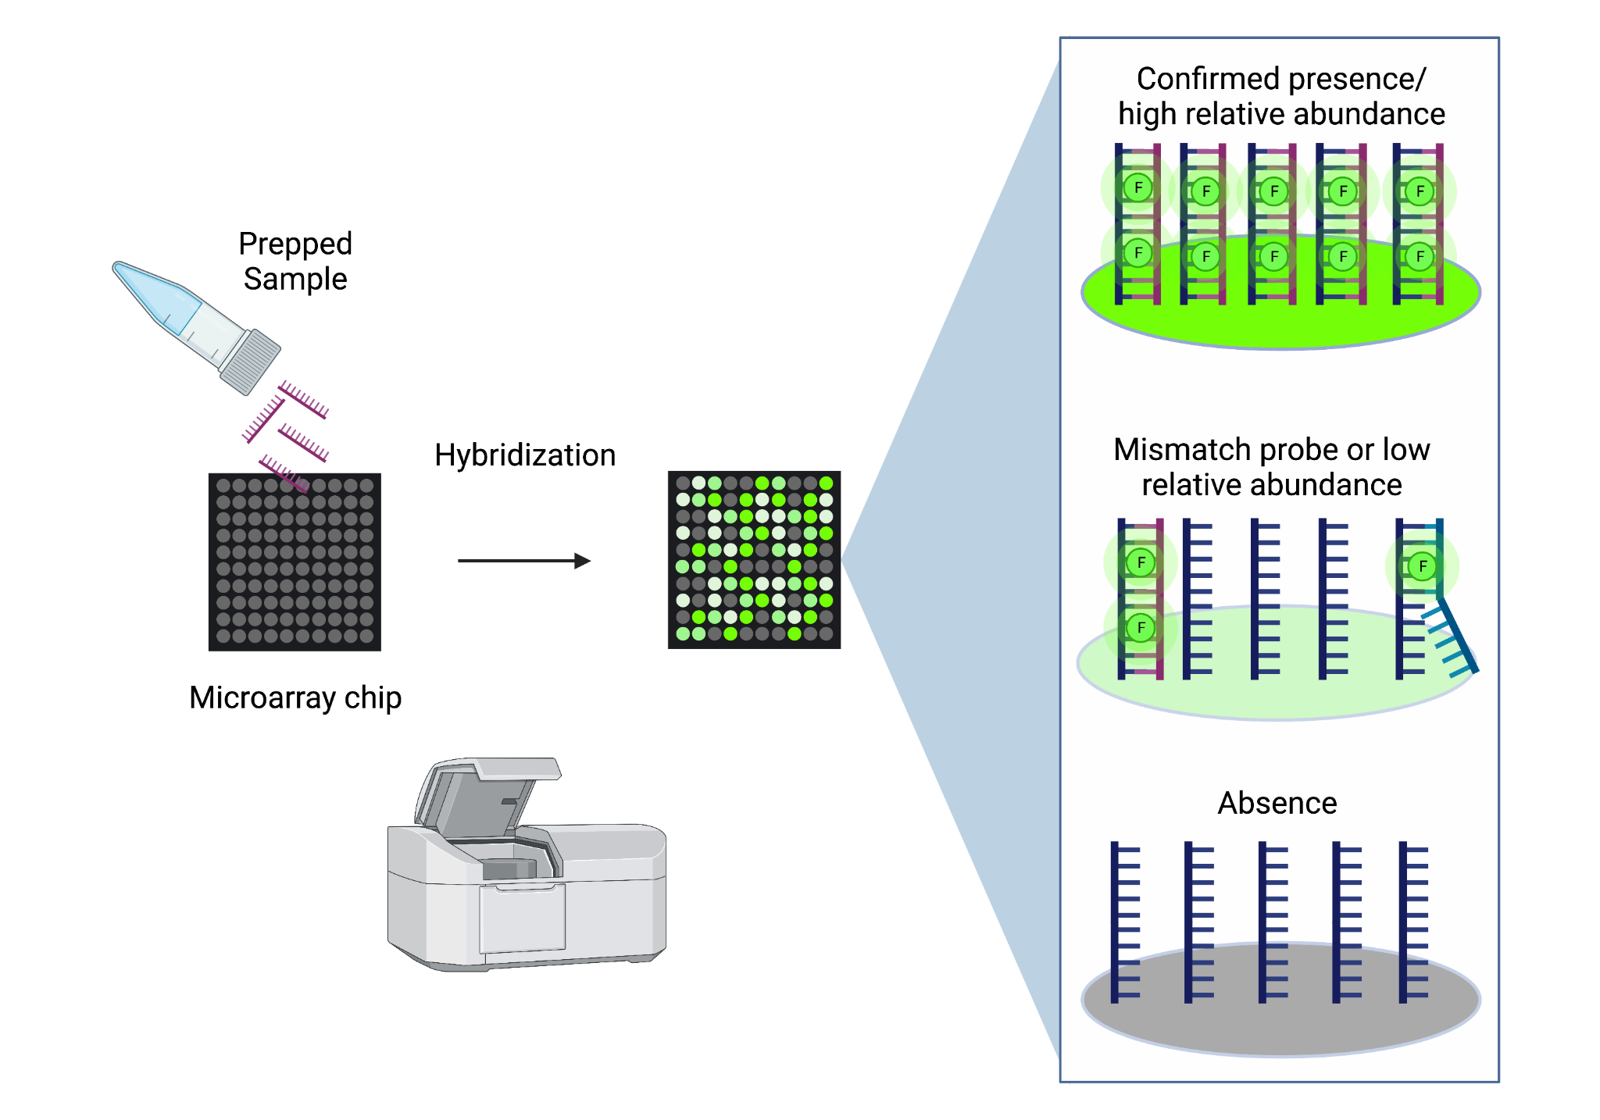
How do microarrays work?
Made with Biorender
Notes:
How do microarrays work in general?

Slide 27
Learning Objectives
This chapter will demonstrate how to:
How do SNP, gene expression, and methylation arrays differ?
Identify the next steps for your particular microarray data.
Formulate questions to ask about your microarray data
Notes:
Learning objectives This chapter will demonstrate how to: Understand what metadata are and why they are so critical. Learn the basics of creating crystal clear, readable metadata

Slide 28
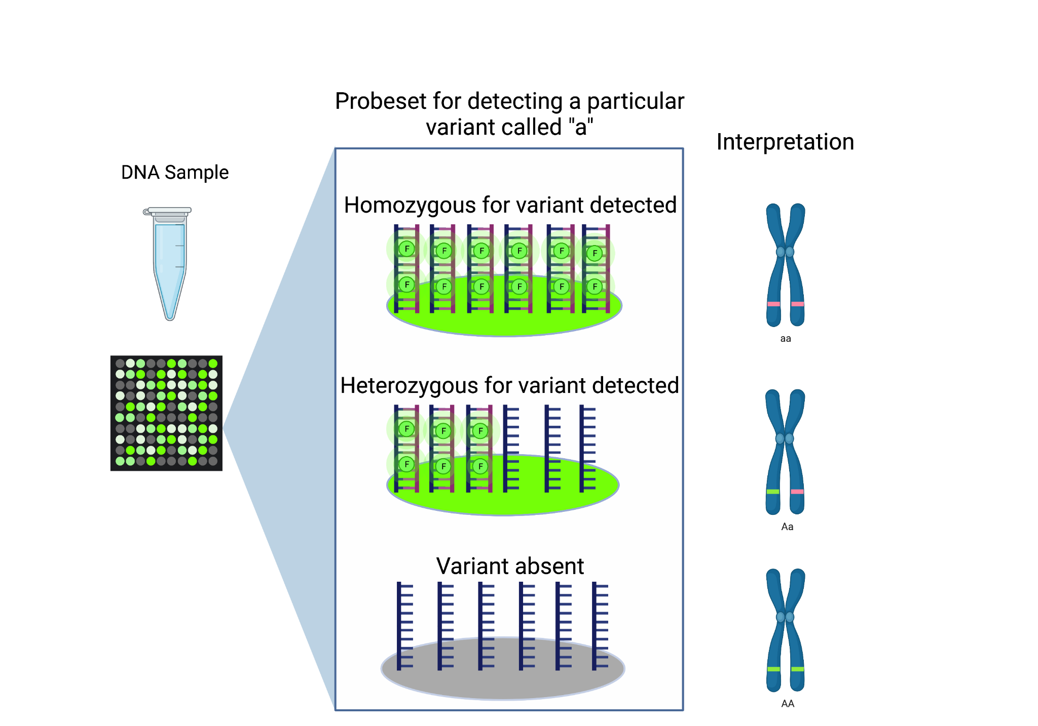
Made with Biorender

Slide 29
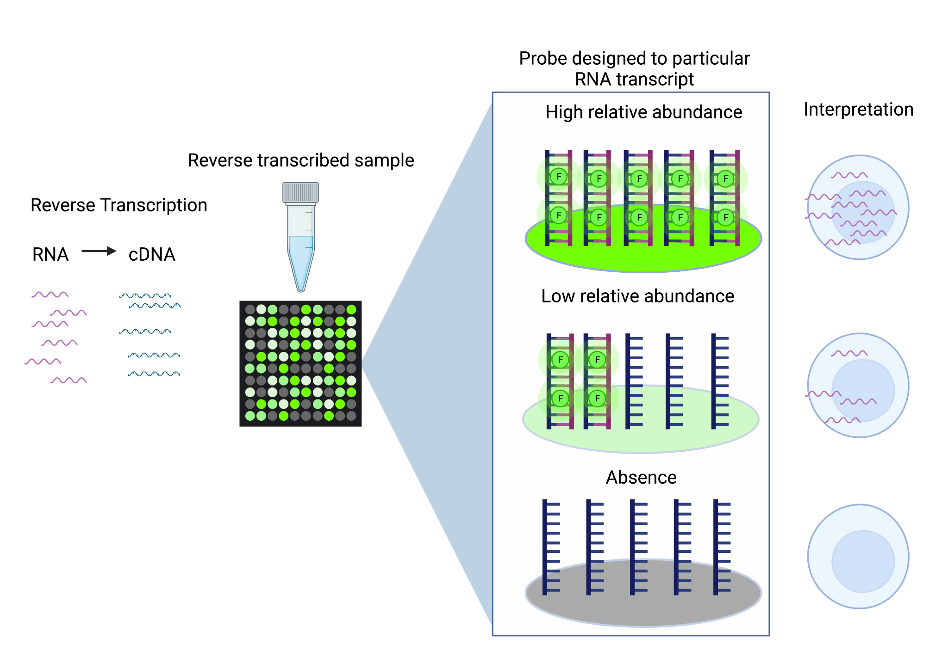
Made with Biorender
Notes:
Microarray data is generation using total RNA which is labeled with fluorescent dyes. These are then hybridized to the microarray chip. The higher the fluorescence, the more RNA that is being detected in the sample. This is assessed chip wide by an image taken of the chip.

Slide 30
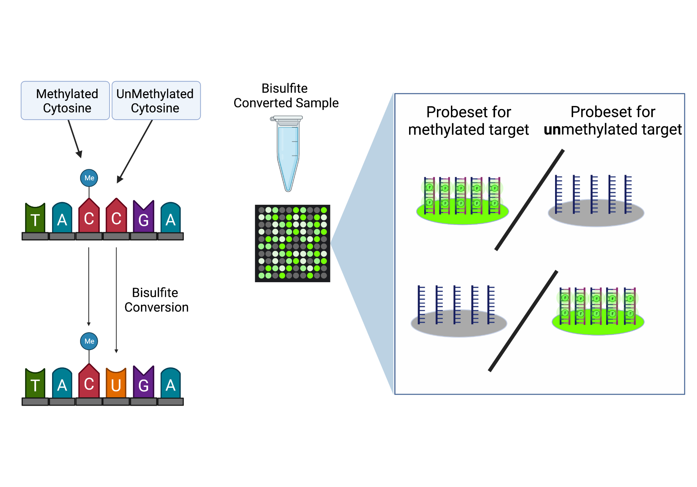
Beta Value
Interpretation
Always methylated
= 1
= 0
Never methylated
Made with Biorender

Slide 31
A very very general microarray file format workflow
Image by Candace Savonen using SmartDraw

Slide 32
Checklist guide to microarray
What is the experimental design?
What is the microarray measuring?
Is the microarray one color or two color?
What is the brand of the microarray used?
What is the name of the chip design used? E.g. U133A
What processing steps have been done thus far?
If applicable, what normalization method was used?
From http://hutchdatascience.org/Choosing_Genomics_Tools/

Slide 33
Learning Objectives
This chapter will demonstrate how to:
Understand the very general basics of sequencing data collection and processing workflow
Understand the limitations and strengths of sequencing data in general.
Notes:
This chapter will demonstrate how to: Understand the very general basics of sequencing data collection and processing workflow. Understand the limitations and strengths of sequencing data in general.

Slide 34
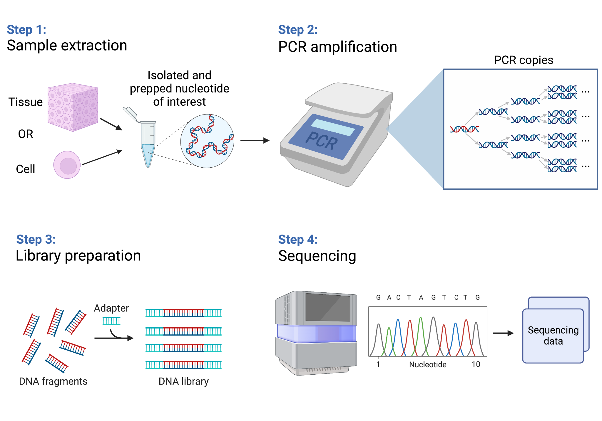
How does sequencing work?
Made with Biorender
Notes:
How does sequencing work?

Slide 35
Sequence related biases
GC bias - guanine and cytosine bond melts at higher temp - if a sequence has a lot of G’s and C’s
Sequence complexity - certain sequences more likely to have primers bound to them (and more likely to be sequenced)
Length bias - longer targets are more likely to be amplified or sequenced
These biases are worsened by PCR amplification!
Notes:
Sequence related biases GC bias - guanine and cytosine bond melts at higher temp - if a sequence has a lot of G’s and C’s Sequence complexity - certain sequences more likely to have primers bound to them (and more likely to be sequenced). Length bias - longer targets are more likely to be amplified or sequenced. These biases are worsened by PCR amplification!

Slide 36
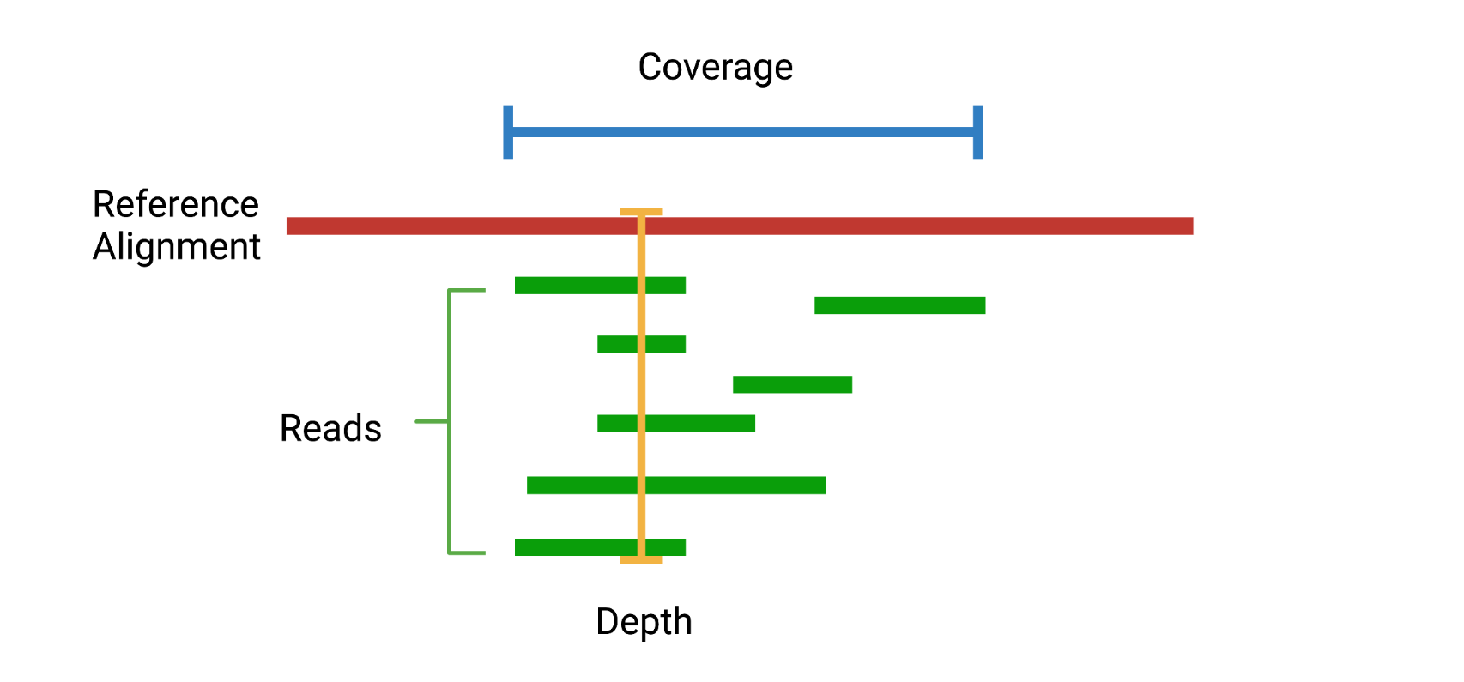
Depth and coverage
Image made by Candace Savonen with Biorender

Slide 37
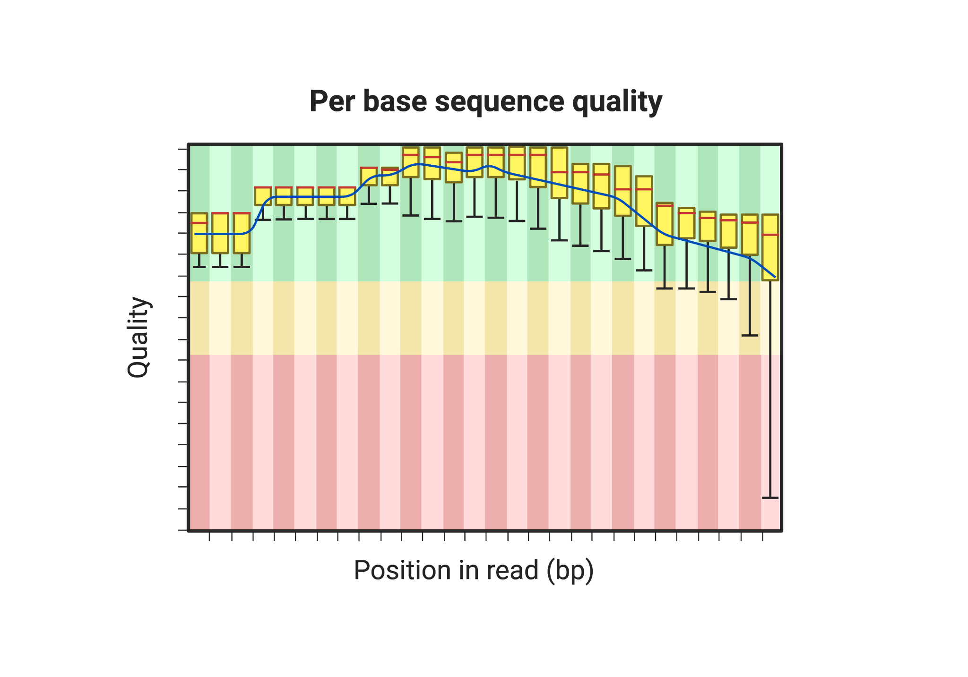
Quality Controls
Image from Biorender

Slide 38
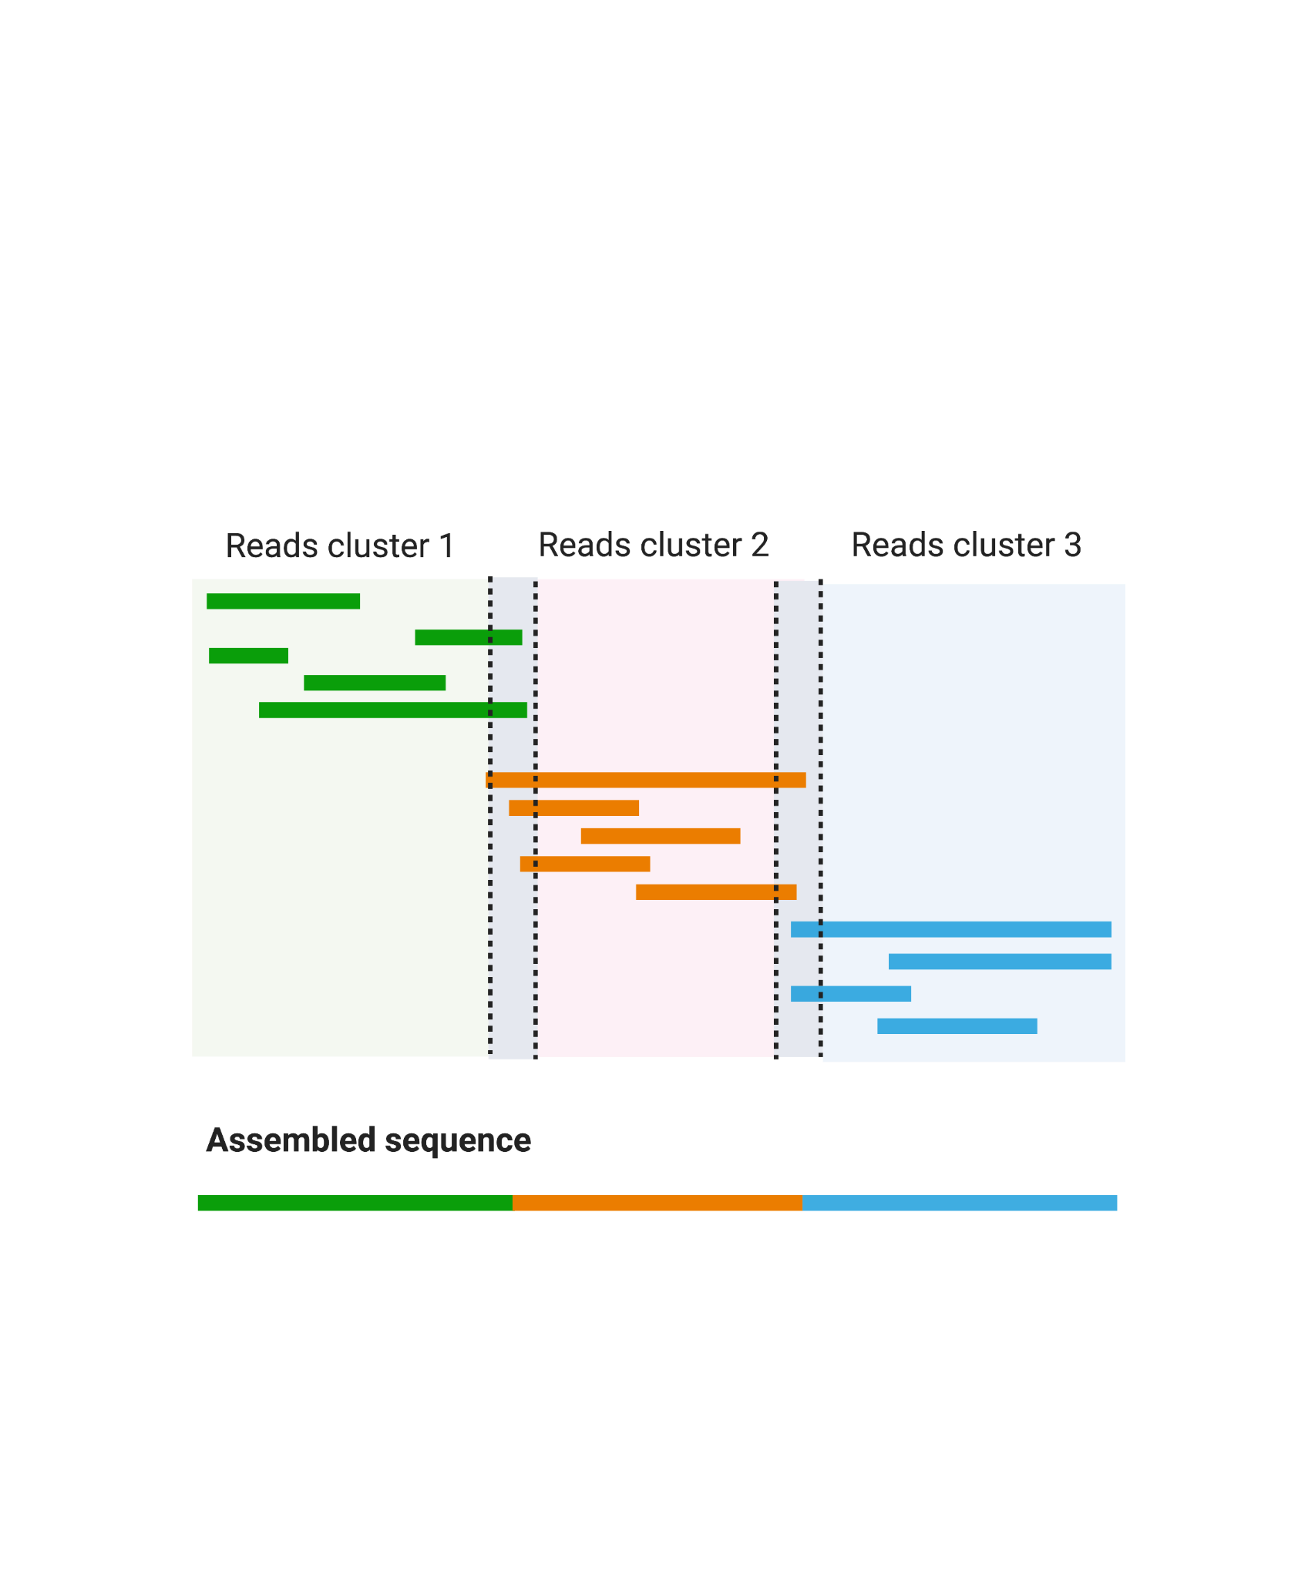
Alignment
Image from Biorender

Slide 39
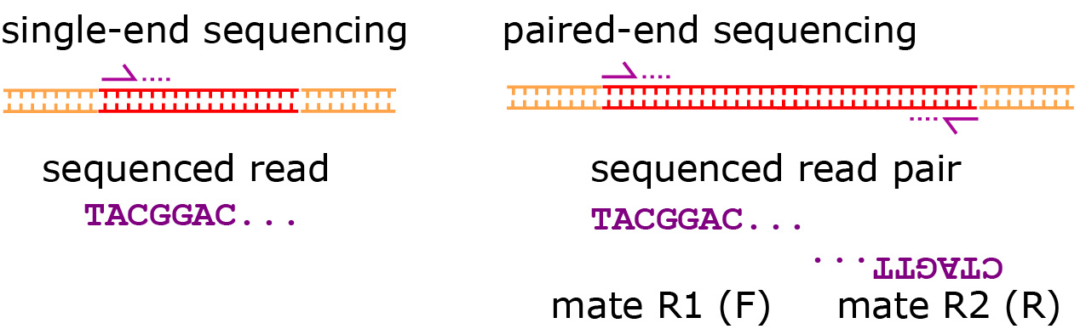
Single-end vs paired-end
Image from https://open.oregonstate.education/appliedbioinformatics/chapter/chapter-6/

Slide 40
Learning Objectives
This chapter will demonstrate how to:
Understand the goals and data collection for DNA sequence collection and variant identification
Compare and contrast the following methods:
DNA/SNP microarrays
Whole Genome Sequencing
Whole Exome Sequencing
Targeted Sequencing
Notes:
Learning objectives This chapter will demonstrate how to: Understand the goals and data collection for DNA sequence collection and variant identification. Compare and contrast the following methods: DNA/SNP microarrays, Whole Genome Sequencing, Whole Exome Sequencing, and Targeted Sequencing

Slide 41
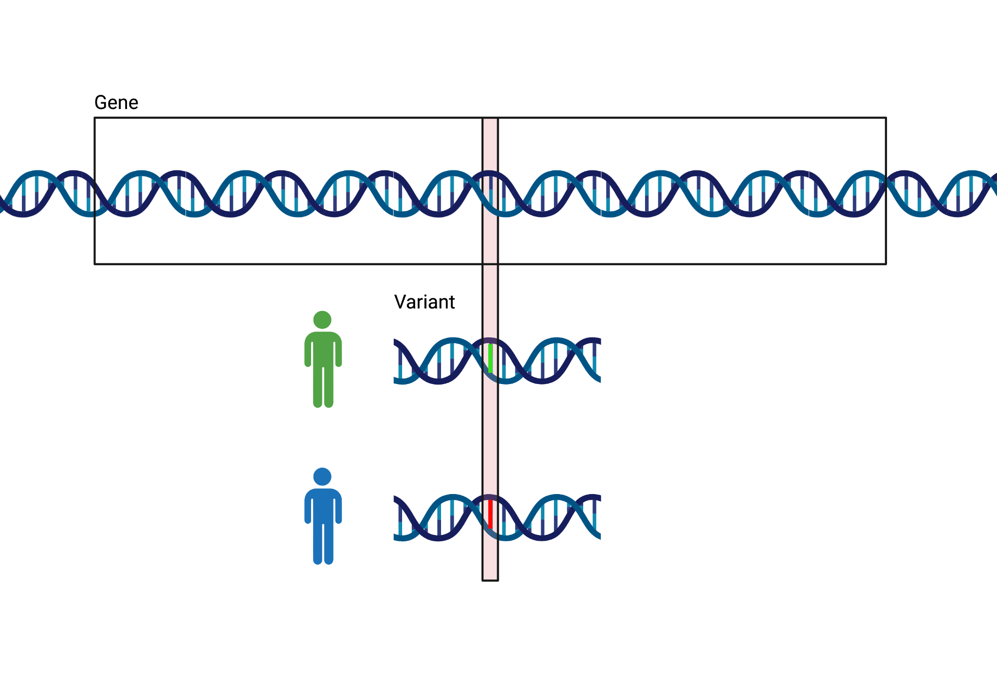
What do DNA sequence variants represent?
Modeled after NHGRI twitter diagram. Made with Biorender
Notes:
The goal of gene expression analysis is to quantify RNAs on a genome wide level

Slide 42
Types of sequencing
Whole Genome Sequencing (WGS) - Try to read everything!
Whole Exome Sequencing (WXS) - Try to read protein coding sequences
Targeted Sequencing - Only read things at locations we are aiming for.
Image from Wikipedia

Slide 43
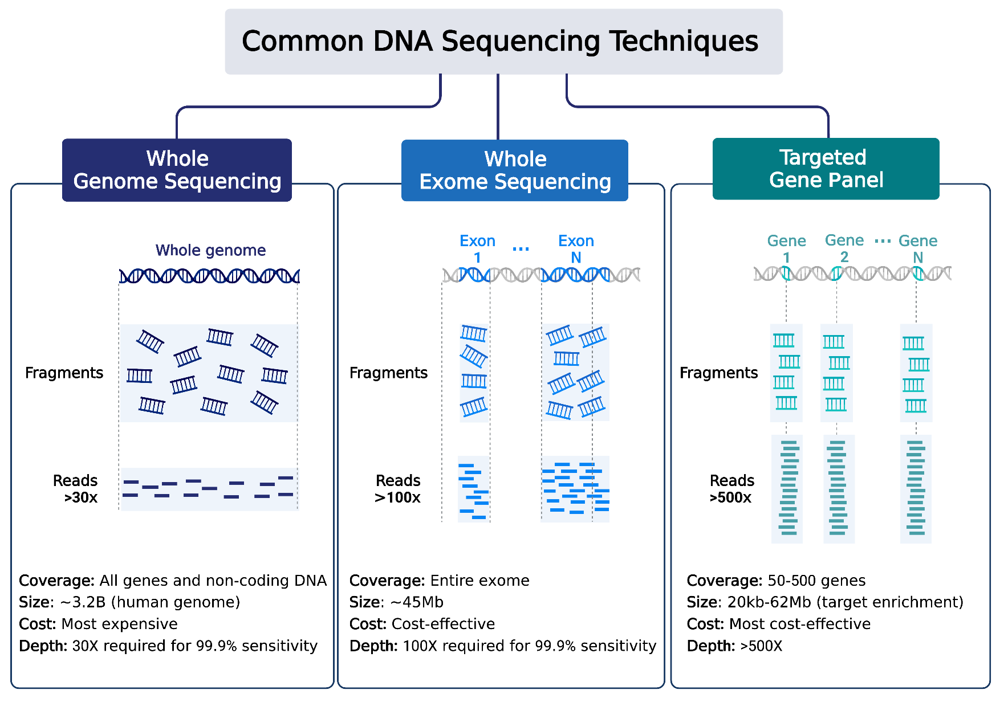
Comparing DNA Sequencing Techniques
Image made by Claire Mills using BioRender
Notes:
Comparing WGS to other sequencing modalities
The most common DNA sequencing techniques are described. Whole genome sequencing coverages all genes and non-coding DNA. 3.2 billion bases are covered when applied to human samples. This the most expensive of the techniques. Depth of coverage required for 99.9% sensitivity is 30X.
Whole exome sequencing coverage is the exome or expressed genes. Approximately 45 million bases are sequenced. This is a cost-effective technique. The depth of coverage required for 99.9% sensitivity is 100X. Targeted gene panel sequencing coverages 50-500 genes. 20,000 to 62 million bases are sequenced. This is the most cost-effective technique. Depth of coverage is >500X.

Slide 44




DNA/SNP microarrays
Whole Genome Sequencing
Whole Exome Sequencing
Targeted Sequencing
Need to check for targets in design
Cost
Computational resources run time required
Image by Candace Savonen with OpenMoji
Notes:
There are three general methods we will discuss for evaluating DNA sequences. Whole Genome Sequencing (WGS) assays more of the genome than other methods but is much more costly and computationally intensive. Depending on your goals WGS may be overkill. SNP microarrays on the other hand, are much more cost effective but are not able to be used for exploratory purposes. Whole Exome Sequencing (WXS or WES) and other targeted sequencing methods allow you to survey regions of the genome in way that is more cost effective and potentially at higher depths.

Slide 45
Learning Objectives
This chapter will demonstrate how to:
Define the uses and applications of WGS/WXS
Describe the steps for generating WGS/WXS data
Understand the data analysis workflow for WGS/WXS
Notes:
Learning Objectives
This chapter will demonstrate how to:
Define the uses and applications of WGS
Describe the steps for generating WGS data
Understand the data analysis workflow for WGS

Slide 46
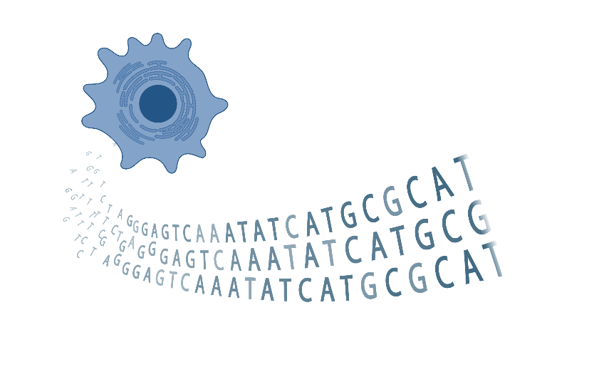
WGS/WXS Overview:
Process of determining DNA sequences of an organism’s genome
Used to identify functional variants associated with disease
Made with BioRender
Notes:
Whole genome sequencing overview
Process of determining entirety of DNA sequence of organism’s genome at single time.
Includes sequencing all chromosomal data and DNA from mitochondria.
Used to identify functional variants associated with disease

Slide 47
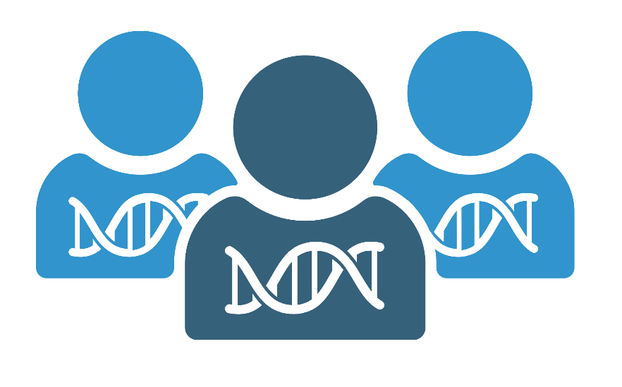
Advantages and Disadvantages of WGS and WXS:
WGS Advantages:
Most complete account of individual variation
Allows for discovery to identify causative variants in protein-coding and regulatory regions of the genome
WGS Disadvantages
Higher cost relative to sequencing protein coding only regions (2-3x higher)
Data generated is much greater with WGS, requiring more robust storage and analysis solutions
Made with BioRender
Notes:
Benefits of WGS:
Most complete account of individual variation
Ability to study:
Structural rearrangements
Copy number variations
Insertion-Deletions
SNPs
Sequencing repeats
Coding, non-coding, and mitochondrial genome coverage
WGS compared to WES:
limited vs entire genome
targeted view of protein-coding regions
WGS allows for discovery - identify causative variants

Slide 48

Considerations:
Genome type/size
Coverage requirements
Tissue source: fresh tissue, FFPE, blood
Library preparation protocol: PCR vs PCR-free
For WXS only: the enrichment method used
Made with BioRender
Notes:
WGS Considerations
Genome type/size
Coverage requirements
Tissue source: fresh tissue, FFPE, blood
Library preparation protocol: PCR vs PCR-free

Slide 49
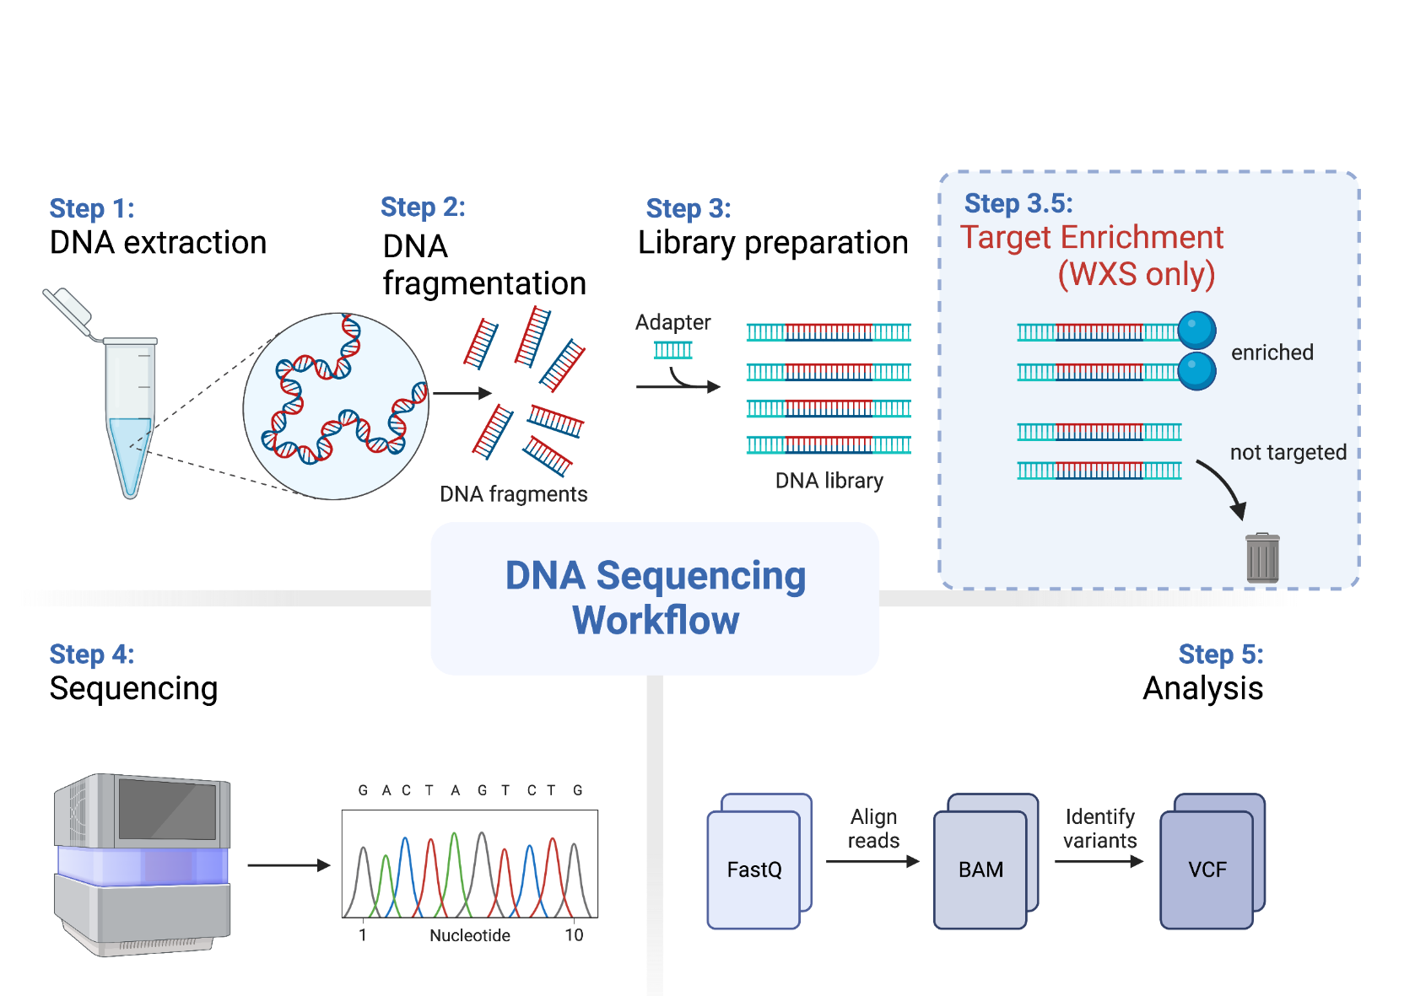
Pipeline Overview:
Image made by Samara Ona on BioRender, modified by Candace Savonen
Notes:
WGS pipeline overview
Step 1: DNA extraction from sample
Step 2: library preparation
Step 3: Sequencing
Step 4: Analysis including data processing from Fastq, aligning reads to generate a BAM file, identifying variants to create a final VCF file

Slide 50
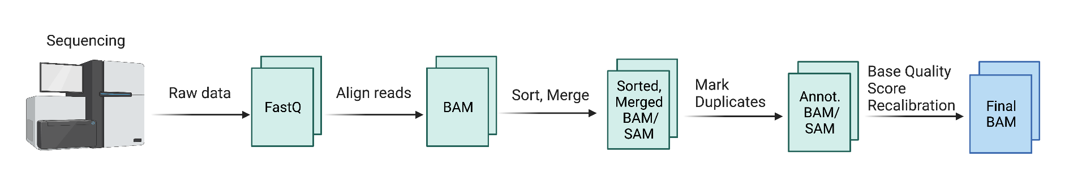
Data Pre-Processing:
Image made by Claire Mills using BioRender
Notes:
WGS data pre-processing pipeline overview:
Raw data from sequencing is transformed into a Fastq file, reads are aligned and a Bam file is created, the data is sorted and marged, duplicates are identified, and the base quality score is recalibrated to create a final BAM file

Slide 51
Commonly Used Tools:
Data Pre-processing | Somatic/Germline Variant Calling | Variant Calling Annotations | Copy Number Variation | Data Visualization
Bedtools | Mutect2 | Annovar | GATK | IGV
Samtools | Varscan 2 | GENCODE | AscatNGS | Maftools
Picard2 | MuSE | dbSNP | TITAN CNA | Prism
GATK | Svaba | Ensembl | gGNV
 | Strelka2 |  | BIC-seq2
 | SomaticSniper
 | Pindel
 | Lancet
Notes:
https://docs.gdc.cancer.gov/Data/Bioinformatics_Pipelines/DNA_Seq_Variant_Calling_Pipeline/
[Name of Link] - what the user sees as a link
(http://www.someurl.com)
Make a table

Slide 52
Checklist guide for DNA Sequencing
Goals:
What is the biological question/hypothesis?
What is the experimental design?
Processing steps:
What was the tissue treatment and source methods?
Is this whole exome or whole genome sequencing?
For exome, what enrichment method was used?
What processing steps have been done?
What tools and parameters were used?
What quality control checks have been done?
From http://hutchdatascience.org/Choosing_Genomics_Tools/

Slide 53
Learning Objectives
This chapter will demonstrate how to:
Understand the goals and data collection processes for gene expression assays
Compare and contrast the following methods:
Gene expression microarrays
Bulk RNA-seq
Single cell RNA-seq
Spatial Transcriptomics
Notes:
Learning objectives This chapter will demonstrate how to: Understand the goals and data collection processes for gene expression assays. Compare and contrast the following methods: Bulk RNA-seq, Single cell RNA-seq, Gene expression microarrays

Slide 54
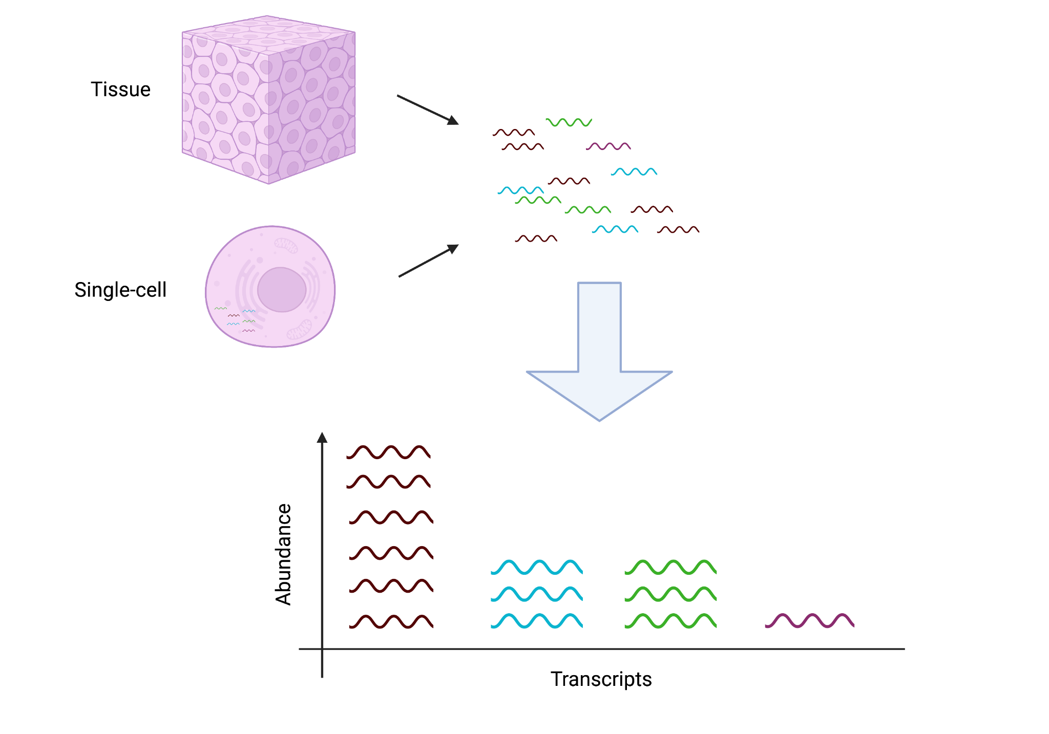
What’s gene expression represent?
RNA transcripts
OR
Notes:
The goal of gene expression analysis is to quantify RNAs on a genome wide level

Slide 55
Gene Expression Microarrays
Single-cell RNA-seq
Spatial transcriptomics
Bulk RNA-seq
Good for cell-level resolution
Need to check for targets in design
Cost
Computational resources run time required
Good for learning about region specific expression
Image by Candace Savonen
Notes:
Gene expression microarrays are low cost and low computationally intensive. Bulk RNA-seq is higher cost, requires more computational resources but covers more targets than gene expression arrays. Single cell RNA-seq is higher cost, requires more computational resources but as opposed to Bulk RNA-seq gives single cell resolution. Spatial transcriptomics is more expensive, and requires more involved computation, but it can give you spatial information that other methods cannot.

Slide 56
Learning Objectives
This chapter will demonstrate how to:
Understand the basics of RNA-Seq data collection and processing workflow
Identify the next steps for your particular RNA-seq data.
Formulate questions to ask about your RNA-seq data
Notes:
This chapter will demonstrate how to: Understand the basics of RNA-Seq data collection and processing workflow. Identify the next steps for your particular RNA-seq data. Formulate questions to ask about your RNA-seq data

Slide 57
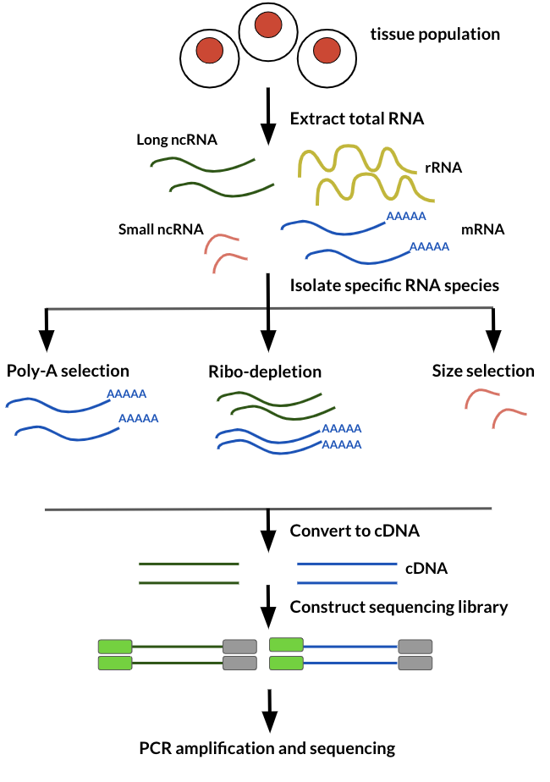
RNA-seq
data generation
From the Childhood Cancer Data Lab: https://alexslemonade.github.io/refinebio-examples/03-rnaseq/00-intro-to-rnaseq.html
Notes:
Bulk RNA-seq data is generated by extracting total RNA and then isolating RNA specific species by either Poly-A selection, Ribo depletion, or size selection. The isolated RNA is then converted to cDNA so it is more stable for sequencing. This cDNA is used to construct a sequencing library. Lastly PCR amplification is used to make many copies to use for sequencing.

Slide 58
When looking for tools to use with your data, see if the algorithms or options available attempt to account for these biases in some way.
Notes:
When looking for tools, you will want to see if the algorithms or options available attempt to account for these biases in some way.

Slide 59
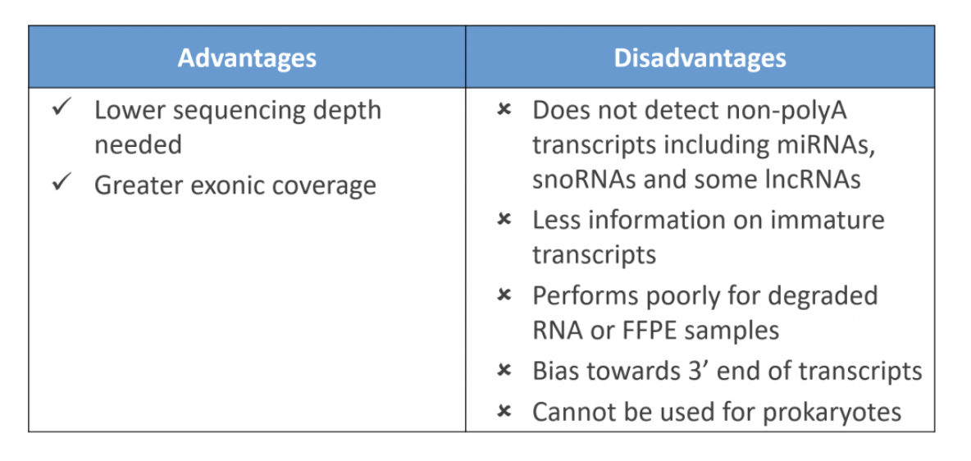
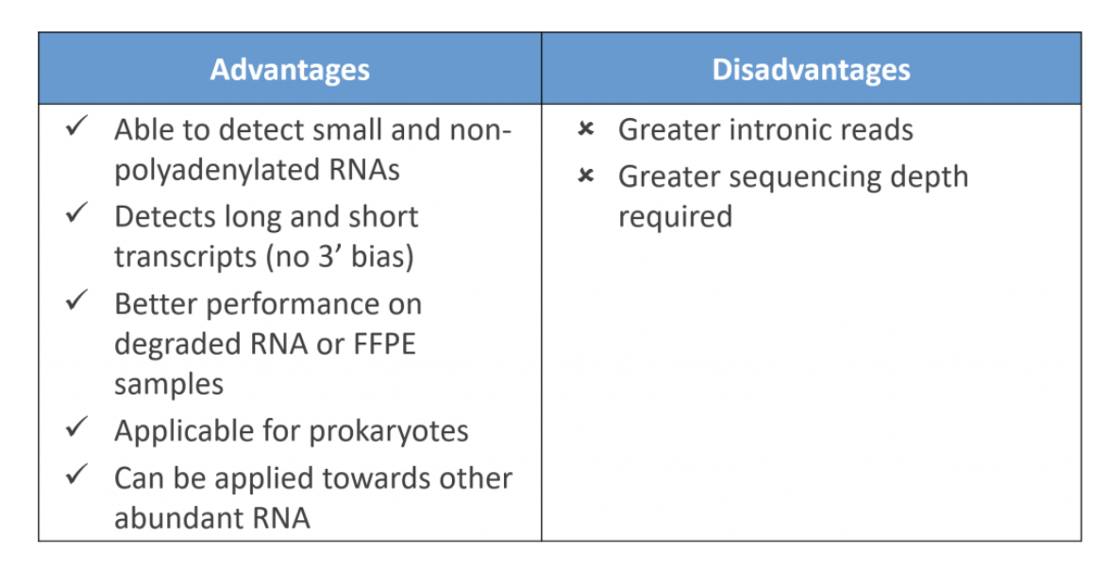
Poly A selection vs Ribo minus
Poly A selection Ribo minus
Tables from SITOOLS BIOTECH blog: https://blog.sitoolsbiotech.com/2019/08/ribo-depletion-rna-seq-ribosomal-rna-depletion-method-works-best/
Notes:
Poly A selection advantages: lower sequencing depth needed. Greater exonic coverage. Disadvantages of Poly A selection is that it does not detect non-polyA transcripts including miRNAs, snoRNAs, and some lncRNAs. It obtains less information on immature transcripts. It performs poorly for degraded RNA or Formalin-Fixed Paraffin-Embedded (FFPE) samples Bias towards 3’ end of transcripts. Cannot be used for prokaryotes. Ribo minus advantages are: It is able to detect small and non-polyadenylated RNAs. It detects long and short transcripts (no 3’ bias). It has better performance on degraded RNa or FFPE samples. It is applicable for prokaryotes. It can be applied toward other abundant RNA. The disadvantages of Ribo minus is that it will collect more intronic reads and immature RNAs (if you are not interested in those). And thus because of the greater quantity of the returned RNA pool. It requires greater sequencing depths.

Slide 60
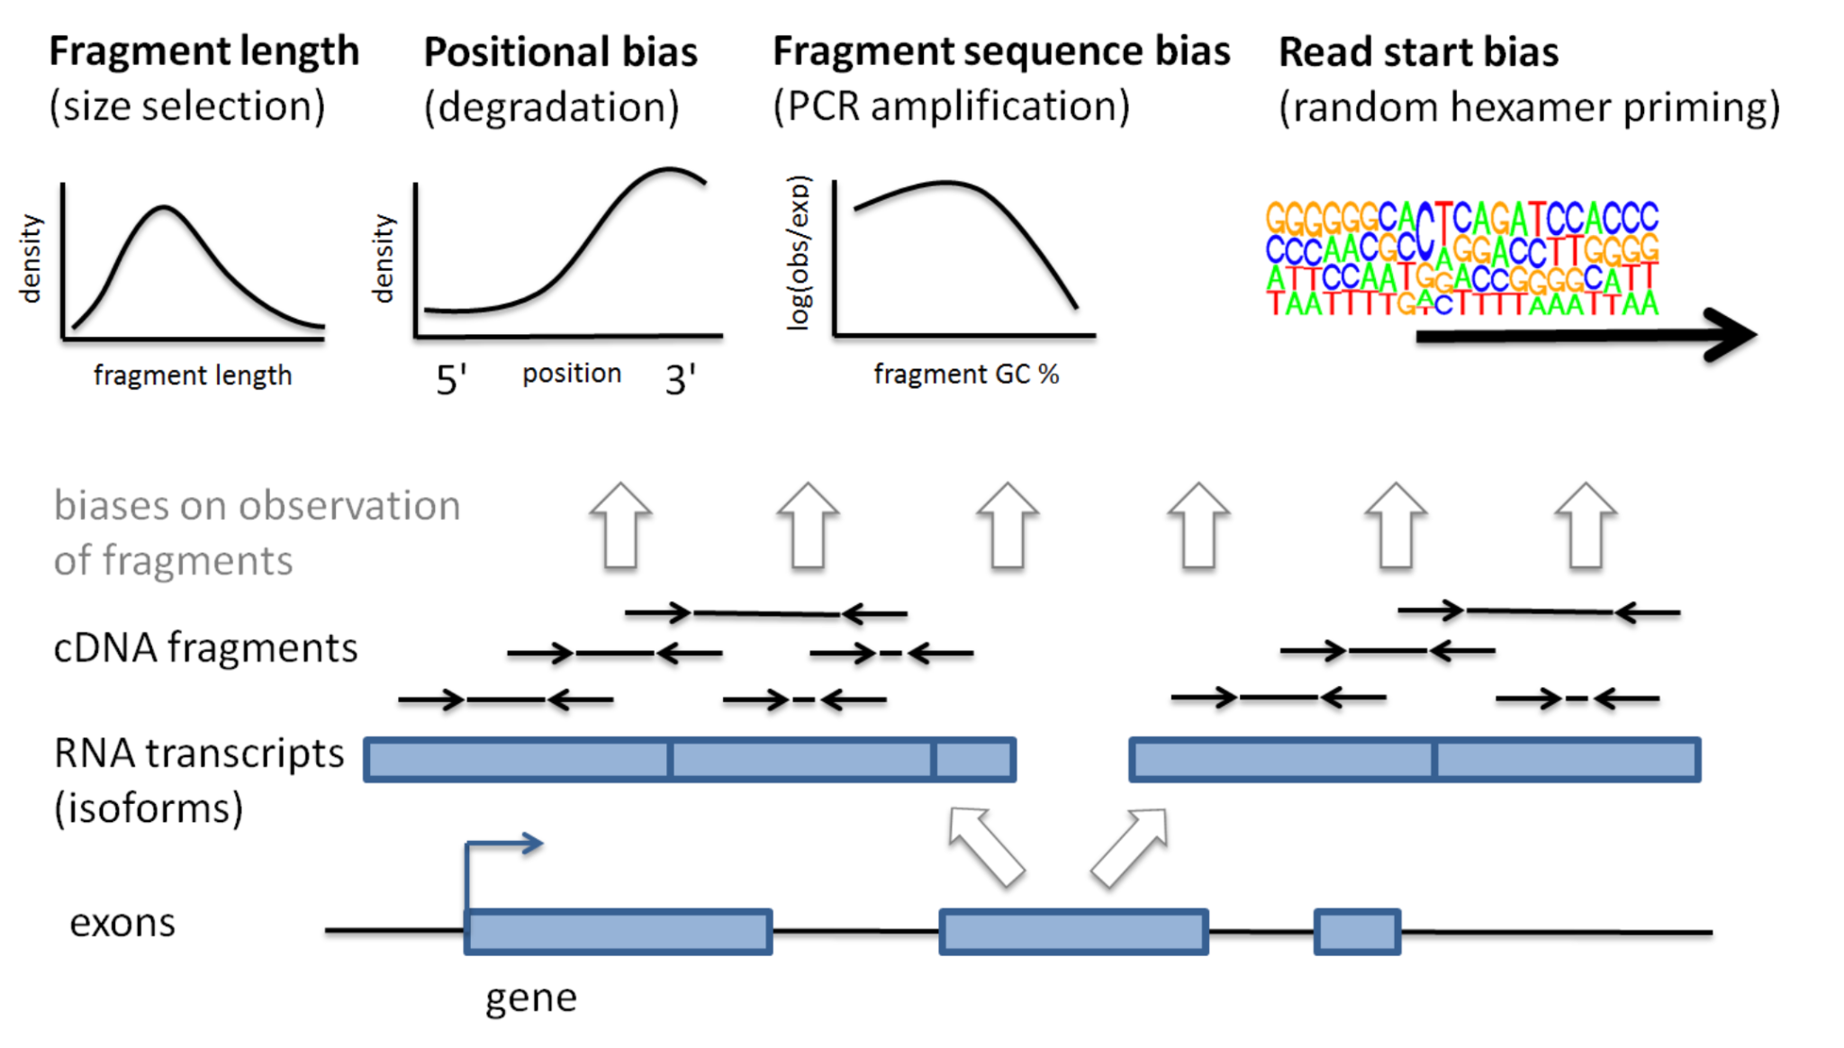
From Mike Love https://mikelove.wordpress.com/2016/09/26/rna-seq-fragment-sequence-bias/
Notes:
RNA-seq data has various biases introduced to the data upon data generation. RNA targets are more likely to be picked up if they are long, if they are from the 3 prime end, have a particular GC content and have a particular read start sequence.

Slide 61
Pay attention to what abundance measures a tool expects to be given with respect to what transformations have already been done to your data (if any).
Notes:
When looking for analysis tools, pay attention to what abundance measures the tool expects to be given with respect to what transformations have already been done to your data (if any).

Slide 62


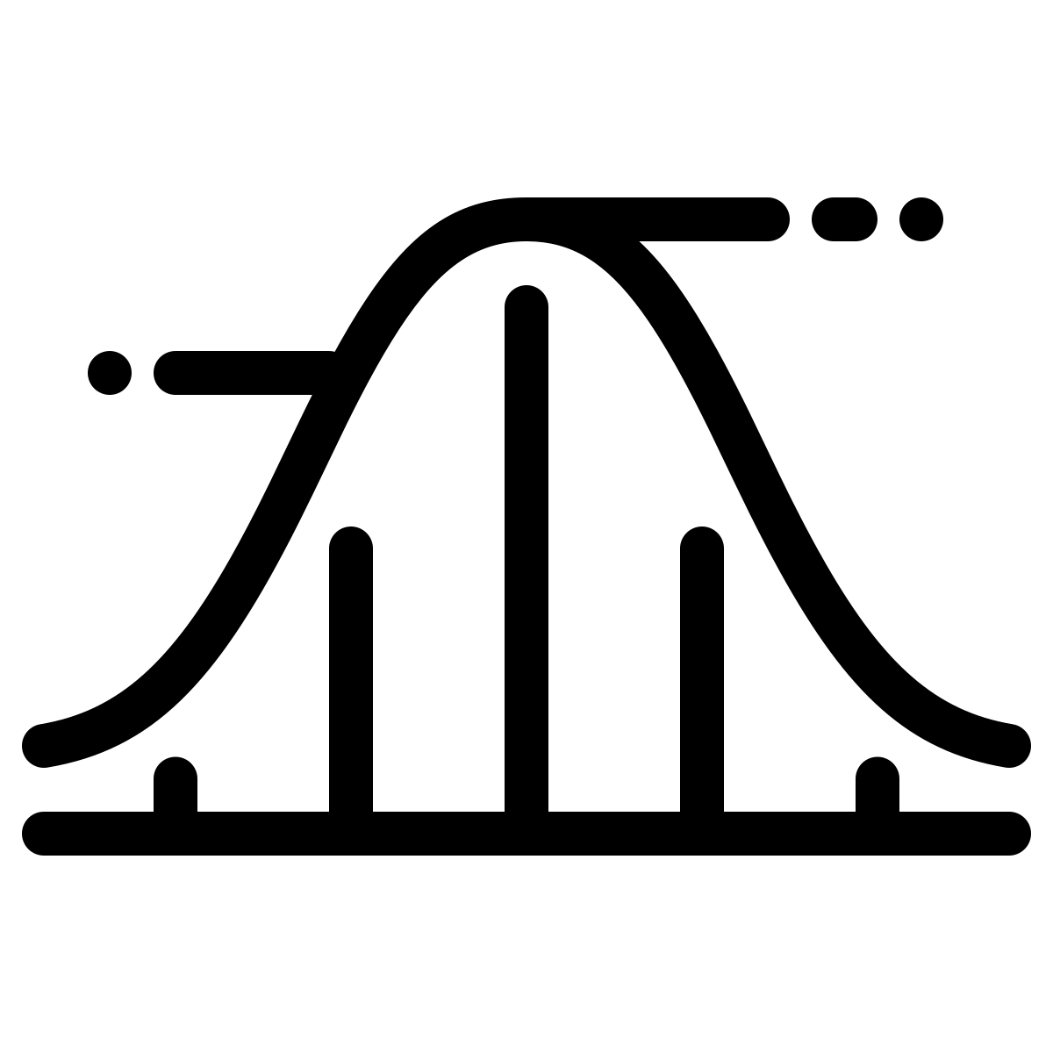

Very general bulk RNA-seq workflow steps
Quality control
Sequence quality
trimming
Quantification/Alignment
Normalization
Downstream analyses
Dimension Reduction
Differential expression
Image by Candace Savonen
Notes:
In a very general sense, RNA-seq workflows involves first quantification/alignment. You will also need to conduct quality control steps that check the quality of the sequencing done. You may also want to trim and filter out data that is not trustworthy. After you have a set of reliable data, you need to normalize your data. After data has been normalized you are ready to conduct your downstream analyses. This will be highly dependent on the original goals and questions of your experiment. It may include dimension reduction, differential expression, or any number of other analyses.

Slide 63
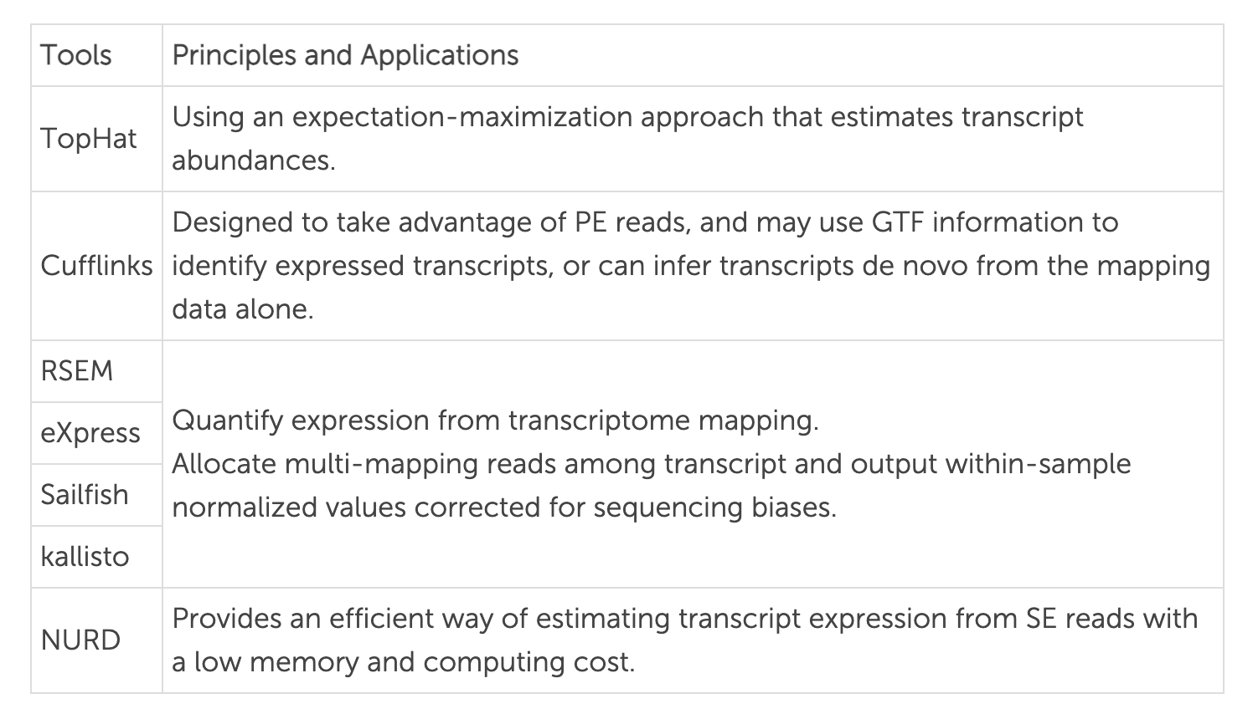
Transcript quantification tools
Salmon/
Table from https://www.cd-genomics.com/resourse-Bioinformatics-Workflow-of-RNA-Seq.html
Notes:
TopHat Uses an expectation-maximization approach that estimates transcript abundances. Cufflinks is designed to take advantage of PE reads, and may use GTF information to identify expressed transcripts, or can infer transcripts de novo from the mapping data alone. RSEM, eXpress, Sailfish, Kallisto, and Salmon - Quantify expression from transcriptome mapping and allocate multi-mapping reads among transcript and output within-sample normalized values corrected for sequencing biases. NURD Provides an efficient way of estimating transcript expression from SE reads with a low memory and computing cost.

Slide 64
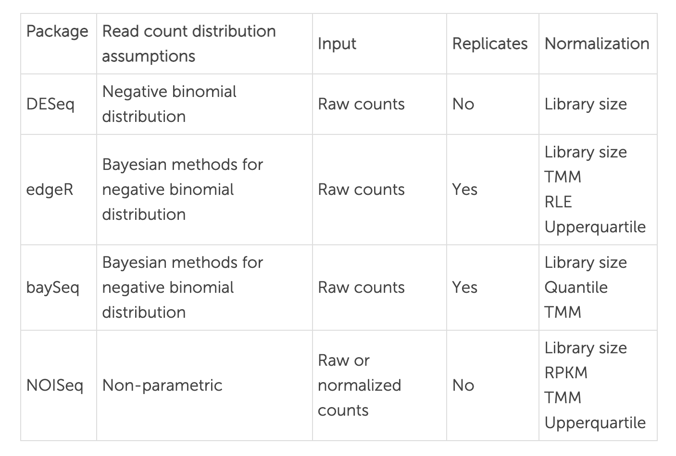
Normalization tools
Table from https://www.cd-genomics.com/resourse-Bioinformatics-Workflow-of-RNA-Seq.html
Notes:
For DESeq: Read count distribution assumes a negative binomial distribution. Raw counts are expected. Replicates are not dealt with.Normalization is done with respect to Library size. For edgeR: Read count distribution assumes Bayesian methods for negative binomial distribution Input is raw counts. Yes, can deal with replicates. Normalization is done with respect to Library size, TMM, RLE, Upperquartile. For baySeq: Read count distribution assumes bayesian methods for negative binomial distribution. Input is raw counts. Can deal with replicates. Library size, Quantile, TMM For NOISeq: Read count distribution is assumed to be Non-parametric. Input is raw or normalized counts Does not deal with replicates. Normalization is done with respect to Library size, RPKM, TMM, Upperquartile

Slide 65
Checklist guide for RNA Sequencing
What is the biological question/hypothesis?
What is the experimental design?
What RNA selection was used: Poly A or Ribo minus?
What processing steps have been done?
What quality control checks have been done?
What alignment methods have been used?
What abundance measures are reported?
From http://hutchdatascience.org/Choosing_Genomics_Tools/

Slide 66
Learning Objectives
This chapter will demonstrate how to:
Understand the basics of single cell RNA-Seq data collection and processing workflow
Identify the next steps for your particular single cell RNA-seq data.
Formulate questions to ask about your single cell RNA-seq data
Notes:
This chapter will demonstrate how to: Understand the basics of single cell RNA-Seq data collection and processing workflow. Identify the next steps for your particular single cell RNA-seq data. Formulate questions to ask about your single cell RNA-seq data

Slide 67
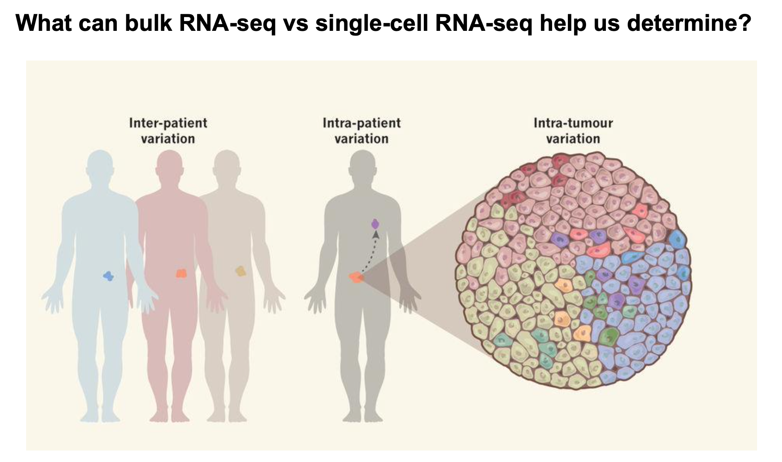
Image from Nature, Tanaka et al, 2018

Slide 68
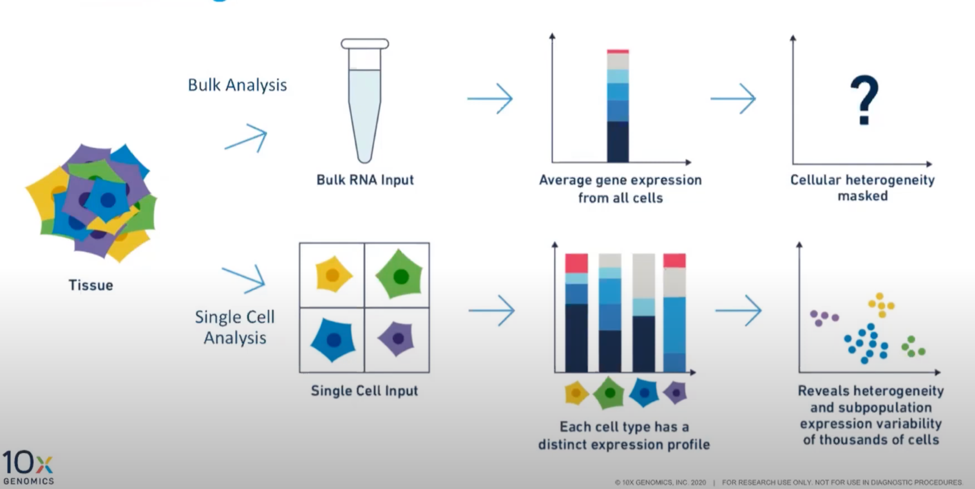
Image from 10X Genomics: https://www.10xgenomics.com/blog/single-cell-rna-seq-an-introductory-overview-and-tools-for-getting-started

Slide 69
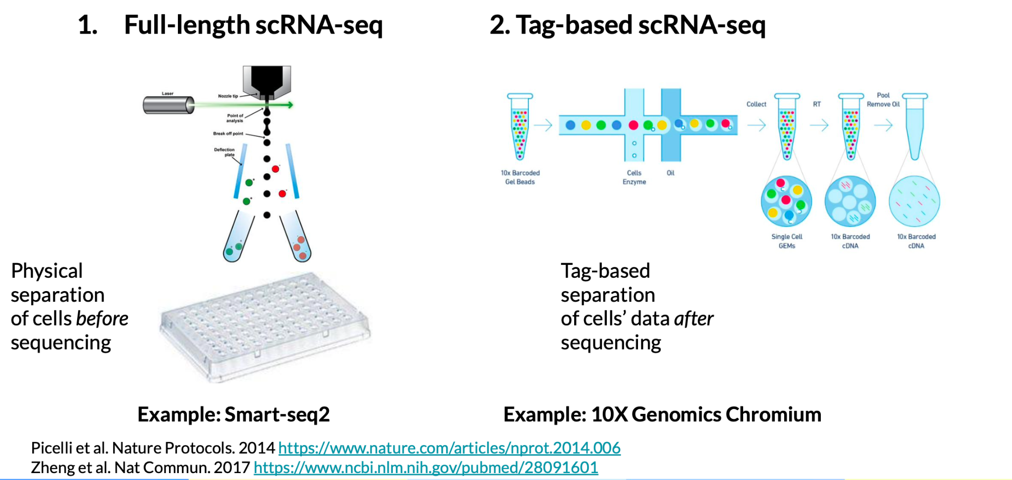
Slide from the Childhood Cancer Data Lab

Slide 70
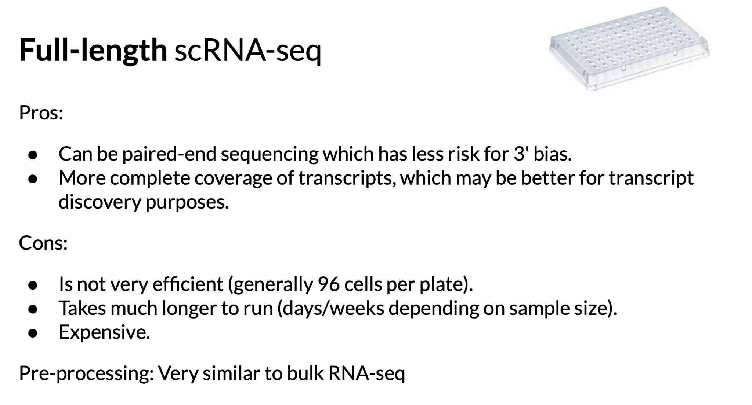
Slide from the Childhood Cancer Data Lab

Slide 71
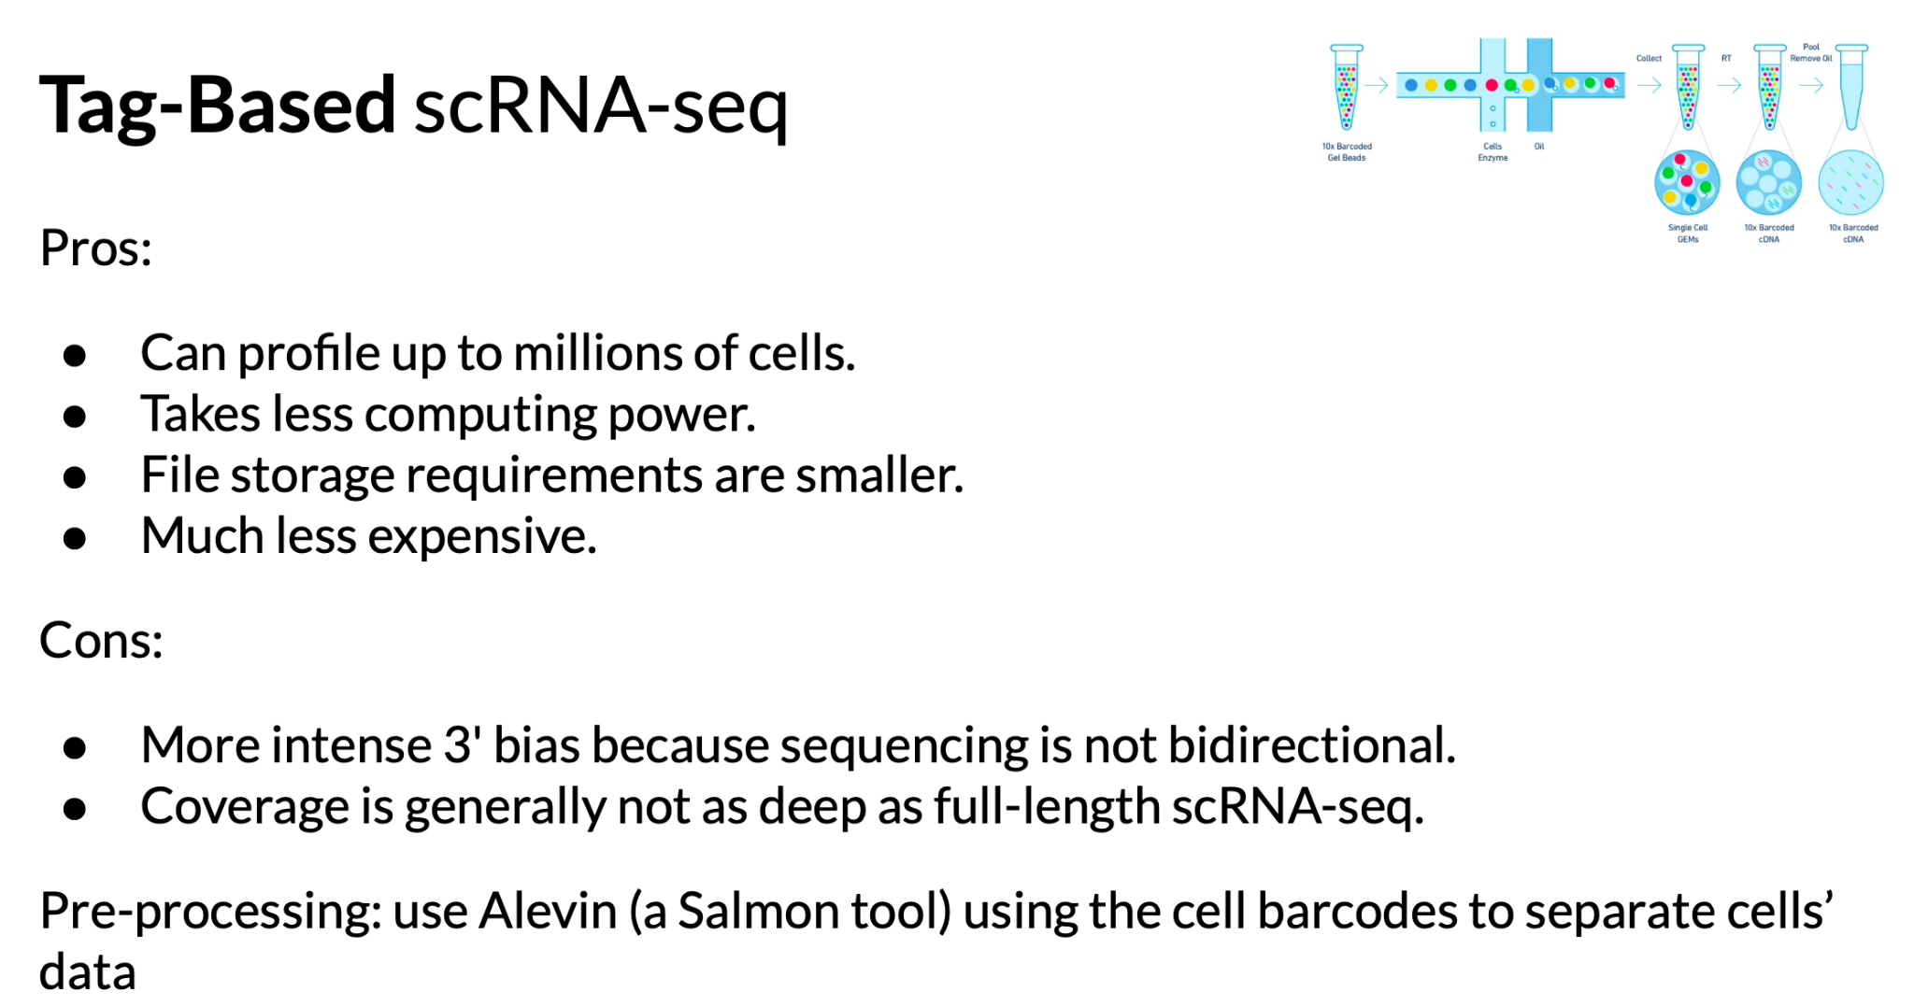
Slide from the Childhood Cancer Data Lab

Slide 72
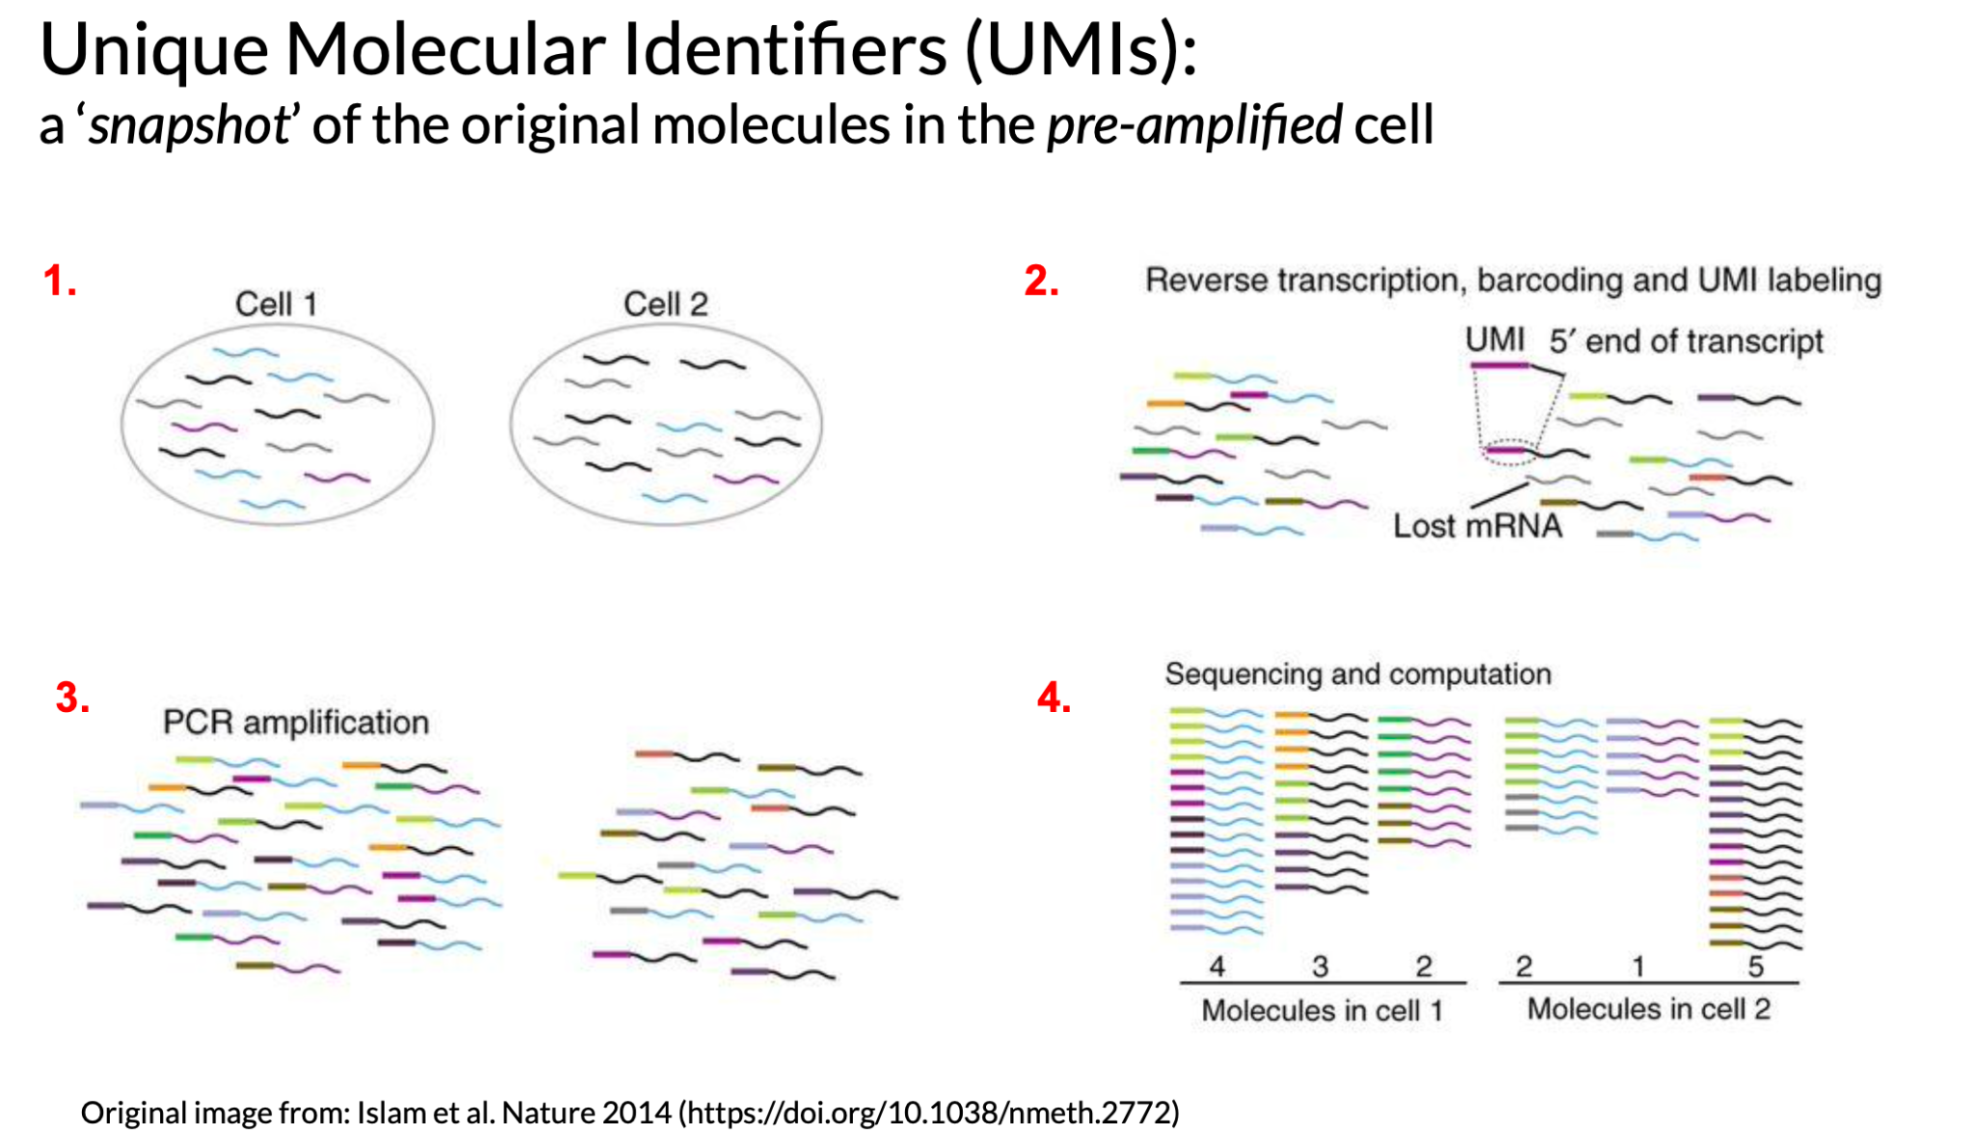
From the Childhood Cancer Data Lab

Slide 73
Very general single cell RNA-seq workflow steps
Quantification/Alignment
Quality control
UMIs
Duplet detection
Filtering
Normalization
Downstream analyses
Dimension Reduction
Cell classification
Differential expression
Trajectory
Image by Candace Savonen
Notes:
In a very general sense, single cell RNA-seq workflows involves first quantification/alignment. You will also need to conduct quality control steps that may involve using UMIs to check for what’s detected, detecting duplets, and using this information to filter out data that is not trustworthy. After you have a set of reliable data, you need to normalize your data. Single cell data is highly skewed - a lot of genes barely or not detected and a few genes that are detected a lot. After data has been normalized you are ready to conduct your downstream analyses. This will be highly dependent on the original goals and questions of your experiment. It may include dimension reduction, cell classification, differential expression, detecting cell trajectories or any number of other analyses.

Slide 74
Checklist guide for single cell RNA Sequencing
What is the biological question/hypothesis?
What is the experimental design?
What general method was used? Full length or tag-based?
What brand of sequencing methods were used? For example: 10X Genomics
What processing steps have been done?
What quality control checks have been done?
Has any analysis for doublets been done?
From http://hutchdatascience.org/Choosing_Genomics_Tools/

Slide 75
Learning Objectives
This chapter will demonstrate how to:
Understand the basics of spatial transcriptomics data collection and processing workflow
Identify the next steps for your particular spatial transcriptomics data.
Formulate questions to ask about your spatial transcriptomics data
Notes:
This chapter will demonstrate how to: Understand the basics of spatial transcriptomics data collection and processing workflow. Identify the next steps for your particular spatial transcriptomics data. Formulate questions to ask about your spatial transcriptomics data

Slide 76
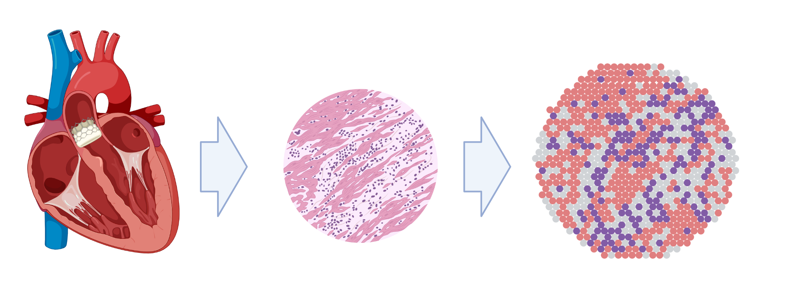
Concept of Spatial Transcriptomics
Gene expression patterns represented from that tissue
Slice of Tissue
Tissue
Made from ready made icons from BioRender
Notes:
The goal of spatial transcriptomics is to understand gene expression but with spatial information. This means a slice or section of a tissue is taken with the goal of having gene expression profiles from the cells on that slide. The cells are tagged based on where they came from in the section so that ultimately the gene expression profiles that result can be traced back to where they originated in the tissue.

Slide 77
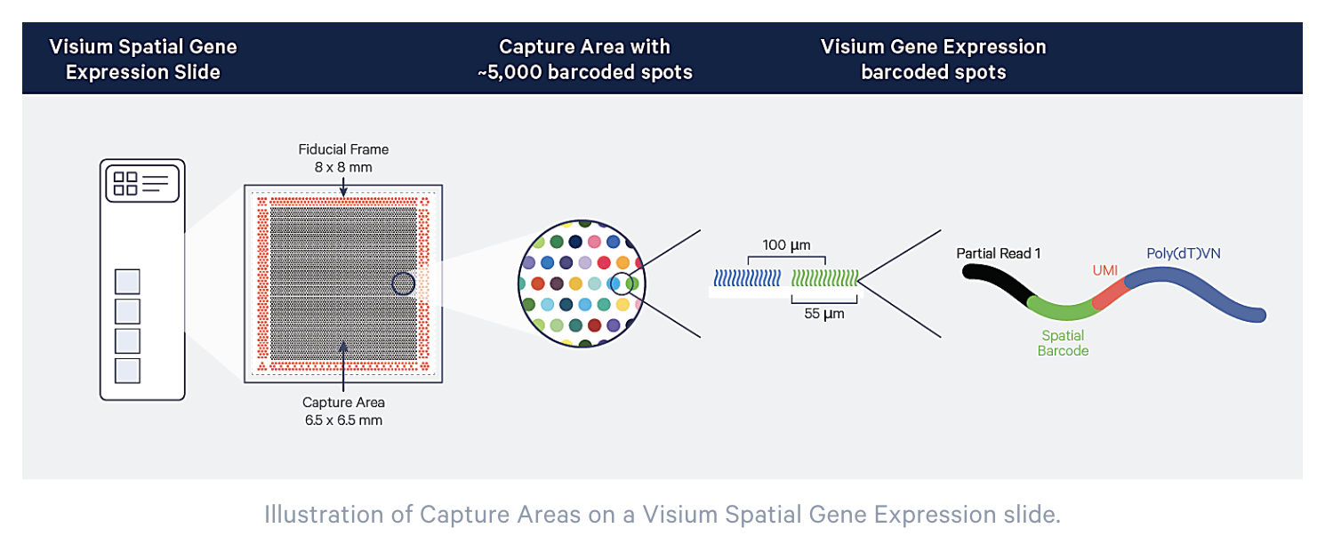
Barcode tells where the sample came from
From 10X Genomics
Notes:
This image from the 10X genomics company explains the methods behind the spatial part of spatial transcriptomics. Essentially each region on a tissue is assigned its own barcode. This barcode is sequenced along with the reads and often a UMI so that later it can be traced back to which spot the read came from.

Slide 78
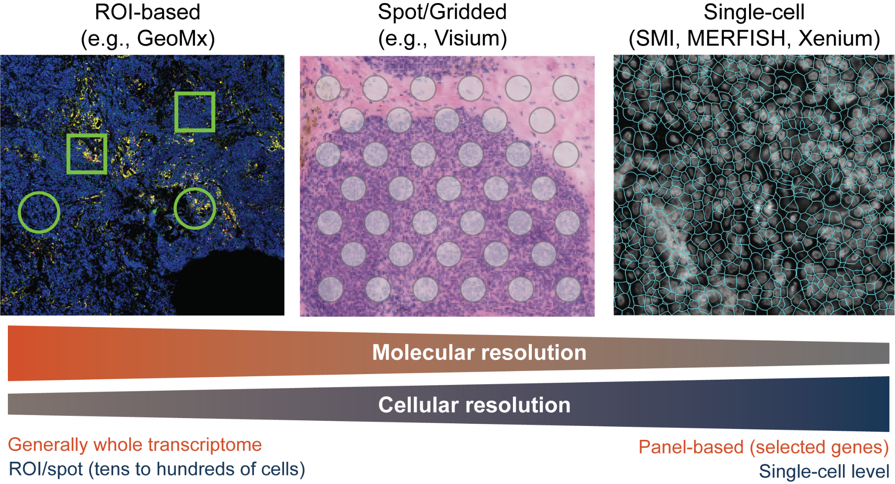

Slide 79
Learning Objectives
This chapter will demonstrate how to:
Understand the goals and data collection processes for chromatin assays
Compare and contrast the following methods:
ATAC-seq
Single cell ATAC-seq
ChIP-seq
CUT&RUN and CUT&Tag
Notes:
Learning objectives This chapter will demonstrate how to: Understand the basics of ATAC-Seq data collection and processing workflow. Identify the next steps for your particular ATAC-Seq data. Formulate questions to ask about your ATAC-Seq data

Slide 80
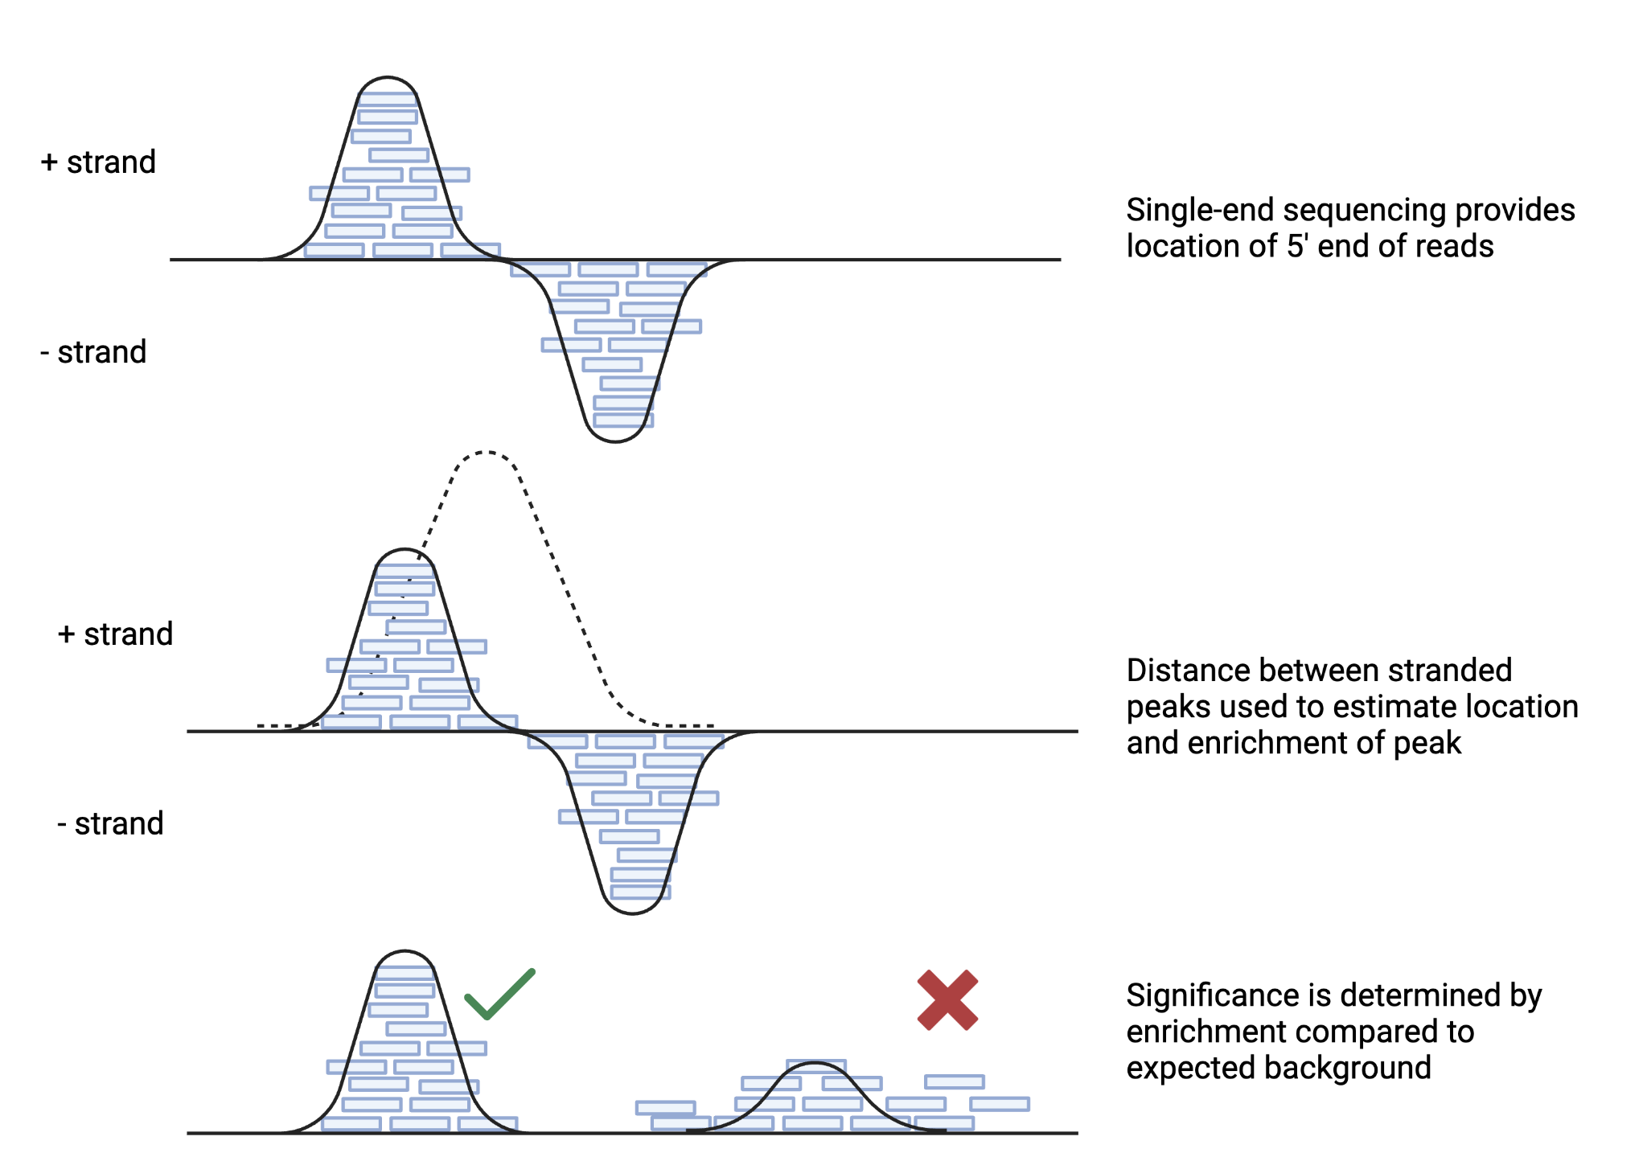
Peak Calling
Notes:
An extensive description of the MACS2 algorithm and use of the software can be found here

Slide 81
Technique | Cost | Difficulty | Experimental Target | Differences in Experimental Question
ATAC-seq | $$ - $$$ | Intermediate | Accessible Chromatin | Identify active regulatory regions
Single-cell ATAC-seq | $$$ - $$$$ | High | Accessible Chromatin at the single-cell level | Study cellular heterogeneity in regulatory regions
ChIP-seq | $$ - $$$ | Intermediate | DNA-binding Proteins | Identify protein-DNA interactions
CUT&RUN | $$ - $$$ | Low | Protein-DNA Complexes | Identify protein-DNA interactions with improved signal-to-noise ratio
CUT&TAG | $$ - $$$ | Low | Protein-DNA Complexes | Identify protein-DNA interactions with reduced background noise
GRO-seq | $$$ - $$$$ | High | Nascent RNA transcripts | Study transcriptional dynamics
DNAse-seq | $ - $$ | Low | Open Chromatin Regions | Identify open chromatin regions
MNase-seq | $$ - $$$ | Intermediate | Nucleosome Positioning | Study nucleosome positioning and DNA accessibility

Slide 82
Learning Objectives
This chapter will demonstrate how to:
Understand the basics of ATAC-Seq data collection and processing workflow
Identify the next steps for your particular ATAC-Seq data.
Formulate questions to ask about your ATAC-Seq data
Notes:
Learning objectives This chapter will demonstrate how to: Understand the basics of ATAC-Seq data collection and processing workflow. Identify the next steps for your particular ATAC-Seq data. Formulate questions to ask about your ATAC-Seq data

Slide 83
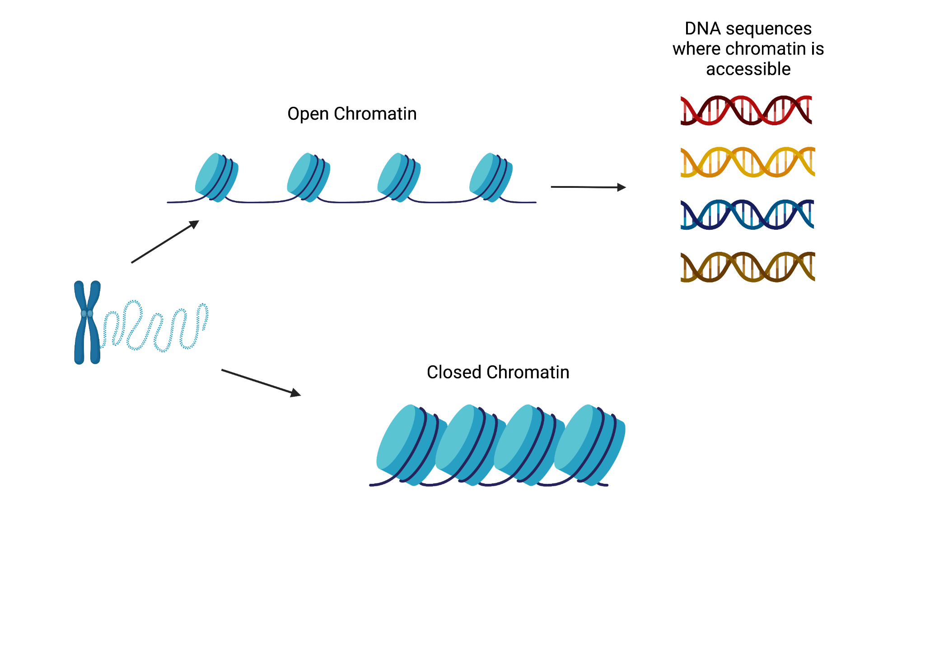

What does accessibility to chromatin represent?
Activity
Made with BioRender
Notes:
What does accessibility to chromatin represent? In ATAC-seq we are able to sequence open chromatin and find out DNA sequences where chromatin is accessible for activity.

Slide 84
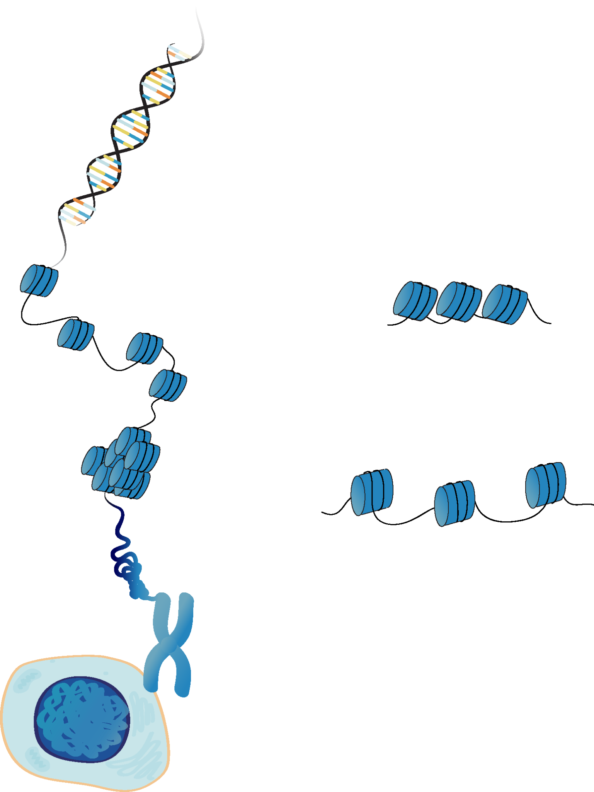
What does accessibility to chromatin represent?
Activity
Notes:
What does accessibility to chromatin represent? In ATAC-seq we are able to sequence open chromatin and find out DNA sequences where chromatin is accessible for activity.

Slide 85
What types of questions can we ask with ATAC-seq?
What regions of the genome have accessible chromatin?
How does accessibility differ between biological samples or change over time?
What transcription factor motifs or transcription factor footprints can be found at accessible regions of interest?
Notes:
What types of questions can we ask with ATAC-seq?What regions of the genome have accessible chromatin? How does accessibility differ between biological samples or change over time? What transcription factor motifs or transcription factor footprints can be found at accessible regions of interest?

Slide 86
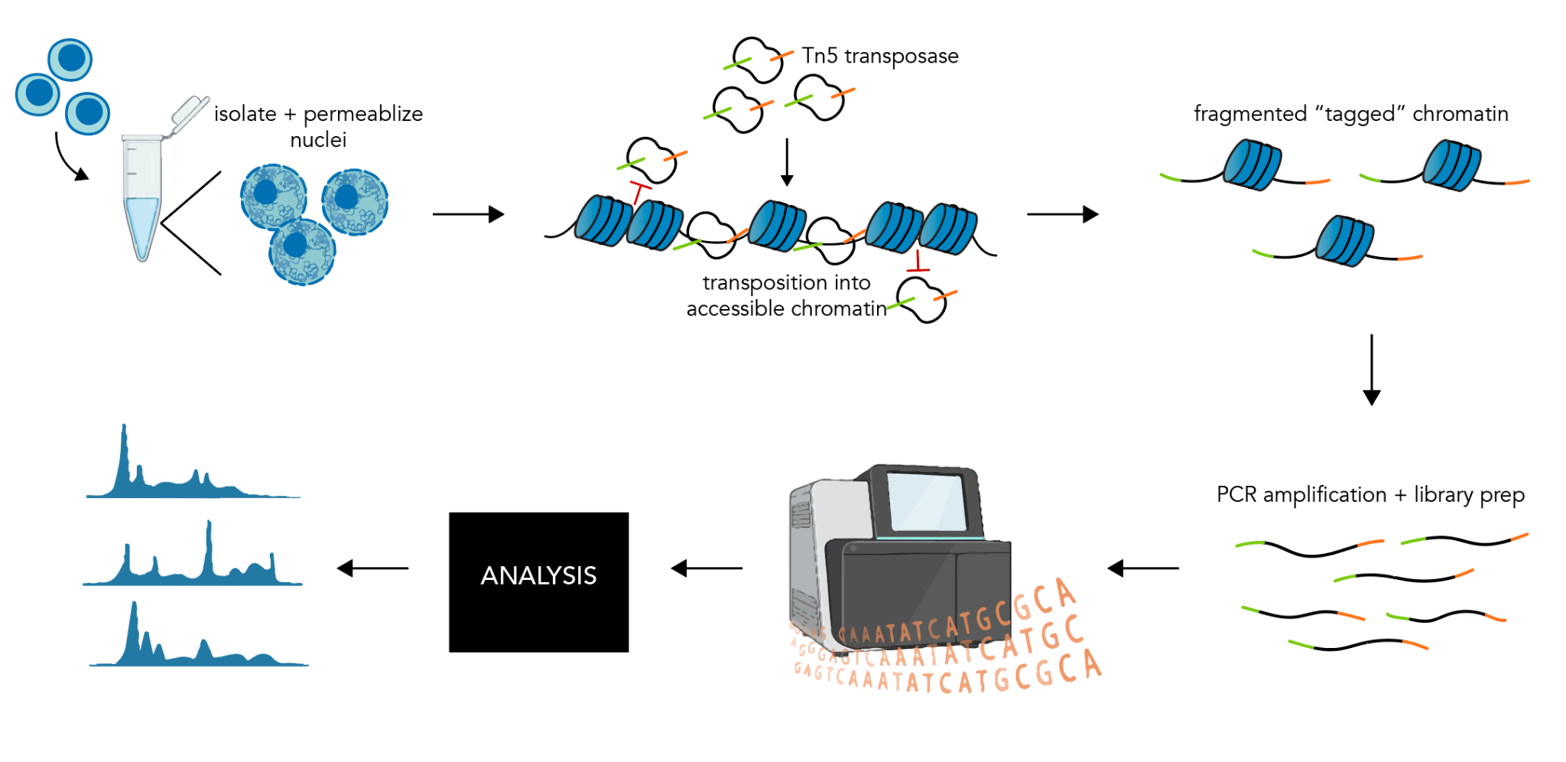
Overview of ATAC-seq
Notes:
A basic ATAC-seq workflow involves mapping sequence reads to the genome, identifying peaks, assessing data quality, and identifying patterns of interest through clustering or identification of differentially accessible regions or other statistical means.

Slide 87
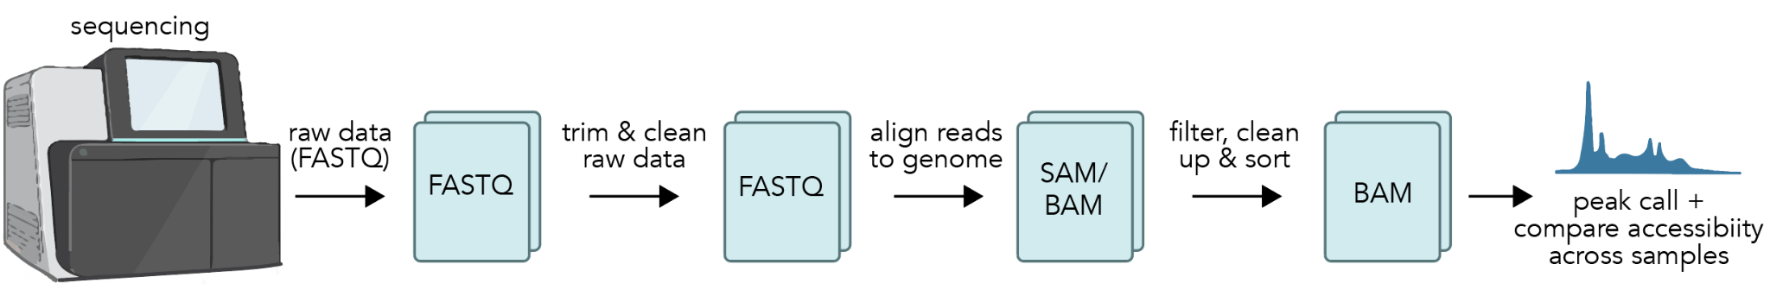
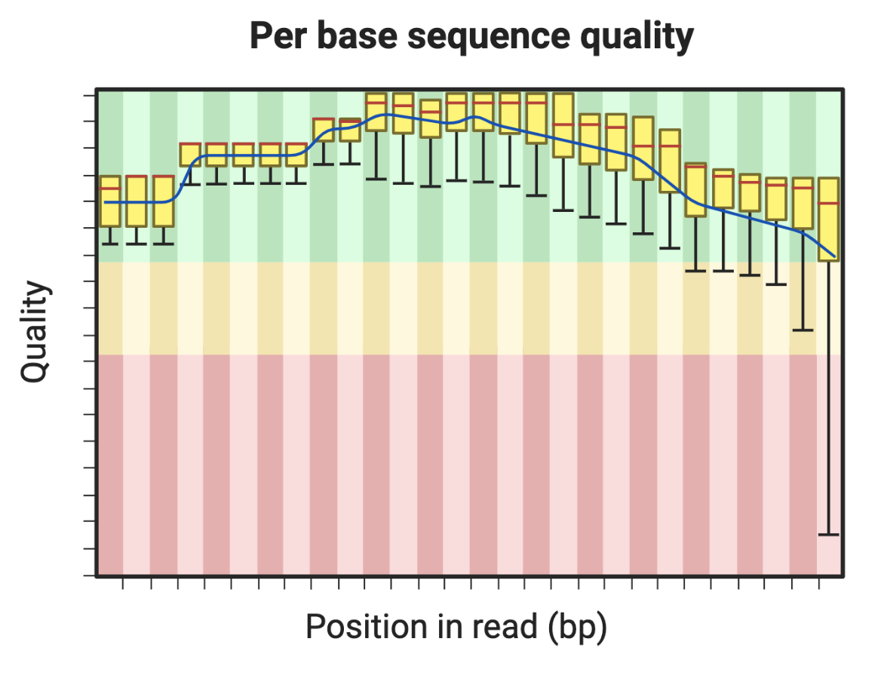
ATAC-seq considerations
What do you need for high quality, reproducible data?
What QC checkpoints can you use to determine if your data looks technically sound?
What to consider when sequencing your samples?
?
?
?
Notes:
What do you need for high quality, reproducible data?
What QC checkpoints can you use to determine if your data looks technically sound?
What to consider when sequencing your samples?

Slide 88
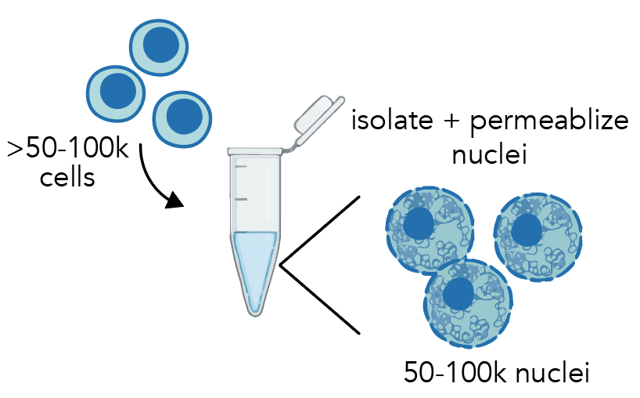
Considerations for quality data: cell numbers & replicates
Cell/nuclei numbers
50-100k nuclei for bulk ATAC-seq
Replicates
Technically, publishing 2 replicates is often acceptable
Due to variability and ensuring reproducibility, 3-4 replicates is ideal

Slide 89
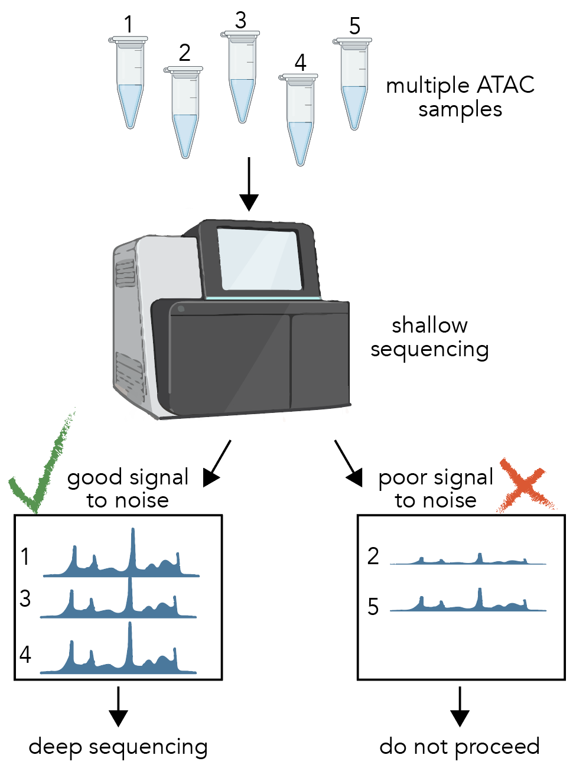
Considerations for quality data: shallow sequencing to screen sample quality
Samples can be sequenced at shallow depths (~2 million reads/sample) to identify high vs. low quality samples
This can allow you to screen many samples cheaply, and identify high quality samples to then sequence deeply
This is particularly useful for optimizing ATAC-seq conditions

Slide 90

Considerations for quality data: QC checkpoints
Pre-sequencing
Library distribution
10x Genomics

Slide 91
Considerations for quality data: QC checkpoints
Post-sequencing
Signal to noise ratio (link resources at end)
Comparison with DNase hypersensitivity datasets (or other computational QC method- check current resources available)
Modify diagram??
Notes:
Post-sequencing. Signal to noise ratio (link resources at end)
Comparison with DNase hypersensitivity datasets (or other computational QC method- check current resources available)

Slide 92
Considerations for sequencing
Single end sequencing
Cheaper
OK for most standard applications
Paired-end sequencing
More expensive
Useful for looking at nucleosome positioning and transcription factor footprinting
Notes:
Single end sequencing. Cheaper. OK for most standard applications. Paired-end sequencing. More expensive. Useful for looking at nucleosome positioning and transcription factor footprinting

Slide 93
Considerations for sequencing
Single vs. paired end sequencing
Single
Cheaper
OK for most standard applications
Paired-end sequencing
More expensive
Useful for looking at nucleosome positioning and transcription factor footprinting
Read length & read depth
75bp or more read length (keep in mind nucleosomes are 147bp)
~50 million reads/sample usually recommended
Notes:
Single vs. paired end sequencing. Single. Cheaper. OK for most standard applications. Paired-end sequencing. More expensive. Useful for looking at nucleosome positioning and transcription factor footprinting. Read length & read depth. 75bp or more read length (keep in mind nucleosomes are 147bp). ~50 million reads/sample usually recommended

Slide 94
Overview of ATAC-seq data analysis pipeline

Slide 95
How to deal with replicates?
Peak calling is often performed by pooling reads from two replicates of the same condition
Should also be performed on replicates individually to check peak reproducibility
Can also be done independently on each sample then the resulting peaks merged
this may lose benefit of combined signal from both samples when peak calling

Slide 96
Comparing accessible chromatin between samples

Slide 97
Nucleosome positioning
Simple schematic of identifying peaks vs. nucleosome positioning
List questions different questions that would correspond to one analysis vs. the other
https://genomebiology.biomedcentral.com/articles/10.1186/s13059-020-1929-3

Slide 98

ATAC data visualization: peaks

Slide 99

ATAC data visualization: graphical
ATAC-seq heatmaps (generated from ENCODE data)

Slide 100
ATAC resources

Slide 101
Checklist guide for ATAC-Seq
What is the biological question/hypothesis?
What is the experimental design?
How many samples and replicates?
What are the positive and negative controls?
What processing steps have been done?
What quality control checks have been done?
From http://hutchdatascience.org/Choosing_Genomics_Tools/

Slide 102
Learning Objectives
This chapter will demonstrate how to:
Understand the basics of single cell ATAC-Seq data collection and processing workflow
Identify the next steps for your particular single cell ATAC-Seq data.
Formulate questions to ask about your single cell ATAC-Seq data
Notes:
Learning objectives This chapter will demonstrate how to: Understand the basics of ATAC-Seq data collection and processing workflow. Identify the next steps for your particular ATAC-Seq data. Formulate questions to ask about your ATAC-Seq data

Slide 103

Overview of scATAC-seq data analysis pipeline
note for 10X users: Cellranger performs peak calling before cell calling, but peak calling should be performed on fragment files using a dedicated peak caller like MACS2 for more accurate peak calling.
Notes:
Learning objectives This chapter will demonstrate how to: Understand the basics of ATAC-Seq data collection and processing workflow. Identify the next steps for your particular ATAC-Seq data. Formulate questions to ask about your ATAC-Seq data

Slide 104

scATAC-seq read structure

Slide 105

Doublets
Notes:
Doublets
Multiple cells which receive same barcode
Appear as a single cell in results
Can have gene expression signature of a mix of cell types
Need to be removed from the dataset using doublet detection tools
Scrublet, seurat, etc.

Slide 106
Peak calling
Link to slide in ATAC section
Notes:
https://docs.google.com/presentation/d/1YwxXy2rnUgbx_7B7ENH9wpDX-j6JpJz6lGVzOkjo0qY/edit#slide=id.g2314e2c3f47_0_10

Slide 107

Clustering

Slide 108


Slide 109
Checklist guide for single cell ATAC-Seq
What is the biological question/hypothesis?
What is the experimental design?
How many samples and replicates?
What are the positive and negative controls?
What processing steps have been done?
What quality control checks have been done?
From http://hutchdatascience.org/Choosing_Genomics_Tools/

Slide 110
Learning Objectives
This chapter will demonstrate how to:
Understand the basics of ChIP-Seq data collection and processing workflow
Identify the next steps for your particular ChIP-Seq data.
Formulate questions to ask about your ChIP-Seq data
Notes:
Learning objectives This chapter will demonstrate how to: Understand the basics of ChIP-Seq data collection and processing workflow. Identify the next steps for your particular ChIP-Seq data. Formulate questions to ask about your ChIP-Seq data

Slide 111
ChIP-seq Overview:
An approach for determining protein-DNA interactions via immunoprecipitation of a target chromatin epitope
Used to identify the epigenetic patterns associated with development and disease
Made with BioRender
Notes:
Whole genome sequencing overview
Process of determining entirety of DNA sequence of organism’s genome at single time.
Includes sequencing all chromosomal data and DNA from mitochondria.
Used to identify functional variants associated with disease

Slide 112

What do DNA to protein interactions represent?
Made with BioRender
Notes:
The goal of ChIP-seq is to identify, for a particular DNA binding protein, all of the DNA sequences that it binds to.

Slide 113

Advantages and Disadvantages of ChIP-seq:
ChIP-seq Advantages:
Gold standard for mapping protein-DNA interactions genome-wide
Identifies direct and indirect binding
ChIP-seq Disadvantages
Requires high input material
Low signal-to-noise ratio
Requires high sequencing depth
Cannot distinguish direct from indirect binding
Made with BioRender

Slide 114

ChIP-seq alternatives: CUT&RUN/Tag
Made with BioRender

Slide 115


Slide 116

Adapted from epicypher

Slide 117

Collaborative protocols on protocols.io

Slide 118
Considerations:
Genome type/size and sequencing depth
Antibody quality
Sample quantity and source: cell line, fresh tissue, FFPE, blood
Control experiments: sequencing of IP input or IgG pulldown for enrichment over background
Made with BioRender
Notes:
WGS Considerations
Genome type/size
Coverage requirements
Tissue source: fresh tissue, FFPE, blood
Library preparation protocol: PCR vs PCR-free

Slide 119
Checklist guide for ChIP-Seq
What is the experimental design?
What are the controls to ensure enrichment for the target epitope?
What processing steps have been done?
What quality control checks have been done?
Where is your epitope expected to be and does that align with the data?
From http://hutchdatascience.org/Choosing_Genomics_Tools/

Slide 120

Example ChIP-seq pipeline from ENCODE
From: https://www.encodeproject.org/pipelines/ENCPL272XAE/

Slide 121


Accessing public ChIP-seq data
https://www.encodeproject.org

Slide 122

Visualizing ChIP-seq coverage
https://www.encodeproject.org. Also see: https://genome.ucsc.edu/ and https://software.broadinstitute.org/software/igv/

Slide 123



Aligning ChIP-seq data to genomic features
deepTools (command line or galaxy)
ngsplot (R, Python, Linux, galaxy)
EnrichedHeatmap in R
https://github.com/shenlab-sinai/ngsplot
https://bioconductor.org/packages/devel/bioc/vignettes/EnrichedHeatmap/inst/doc/EnrichedHeatmap.html
https://deeptools.readthedocs.io/en/latest/index.html

Slide 124


Further analysis (e.g., ChIP-seq v. CUT&RUN
Correlate profiles (deepTools)
Compare peaksets (intervene in python)
https://nbis-workshop-epigenomics.readthedocs.io/en/latest/content/tutorials/quantitativeChip/cut-and-run-data.html

Slide 125
Learning Objectives
This chapter will demonstrate how to:
Understand the basics of CUT&RUN data collection and processing workflow
Identify the next steps for your particular CUT&RUN data.
Formulate questions to ask about your CUT&RUN data
Notes:
Learning objectives This chapter will demonstrate how to: Understand the basics of ATAC-Seq data collection and processing workflow. Identify the next steps for your particular ATAC-Seq data. Formulate questions to ask about your ATAC-Seq data

Slide 126
Learning Objectives
This chapter will cover the following materials:
Understand the basics of CUT&RUN and CUT&Tag technologies
Introduce the use and application differences
How to analyze the CUT&RUN and CUT&Tag data and tools for exploration

Slide 127
Technology Summary
Technology | Description | Target | Reference
ChIP-seq | Traditional epigenomic profiling methods that is time consuming and has high background noise. | Histone modification and chromatin proteins | Robertson G et al. Nature Methods. 2007
CUT&RUN | Antibody-target chromatin profiling methods that is easy to conduct and has minimal background noise. | Histone modification, transcription factor, remodelers | Skene et al. eLife. 2017
autoCUT&RUN | Automatic CUT&RUN using a 96-well to profile chromatin for high-throughput samples through robot. | Histone modification, transcription factor, remodelers | Janssen et al. Epigenetics & Chromatin. 2018
CUT&Tag | Overcome limitations of ChIP-seq and CUT&RUN by leveraging proteinA-Tn5 complex loaded with adapters. | Histone modification, RNA PolII | Kaya-Okur et al. Nature Communications. 2019
autoCUT&Tag | Automatic CUT&Tag using a 96-well to profile chromatin for high-throughput samples through robot. | Histone modification, RNA PolII | Janssen et al. Nature Genetics. 2021
CUTAC | A simple modification of CUT&Tag method that provides high-quality accessibility mapping | RNA PolII | Henikoff et al. eLife. 2020

Slide 128

CUT&RUN
Experimental
Procedure

Slide 129

CUT&Tag Experimental Procedure

Slide 130

CUTAC
Compared
with
CUT&Tag

Slide 131

CUT&RUN of H3K27me3 requires only 100 cells to profile the human polycomb chromatin landscape.

Slide 132

CUT&RUN requires only 1,000 cells and 4 million fragments to delineate human CTCF peaks

Slide 133

Chromatin Landscapes Profiled by Different Methods

Slide 134

CUT&RUN/CUT&Tag Data Analysis Workflow

Slide 135

Fragment Length and Periodic Pattern

Slide 136

Comparisons of #Peak and FRiP

Slide 137

Heatmap on CUT&Tag Peaks

Slide 138
Learning Objectives
This chapter will demonstrate how to:
Understand the basics of bisulfite sequencing data collection and processing workflow
Identify the next steps for your particular bisulfite sequencing data.
Formulate questions to ask about your bisulfite sequencing data
Notes:
This chapter will demonstrate how to: Understand the basics of bisulfite sequencing data collection and processing workflow. Identify the next steps for your particular bisulfite sequencing data. Formulate questions to ask about your bisulfite sequencing data

Slide 139

What’s DNA methylation represent?
Made with BioRender
Notes:
The goal of gene expression analysis is to quantify RNAs on a genome wide level

Slide 140



Very general methylation data workflow steps
Quality control
Sequence quality
trimming
Genome Alignment
Methylation calls
Find regions of interest
Image by Candace Savonen
Notes:
In a very general sense, methylation workflow involves sequence quality control and genome alignment like many other sequencing methods. But next, the data needs to be used to identify methylation calls and calculations of methylation fractions. Lastly, you will likely want to group the methylated bases together to identify what regions of the genome are differentially methylated and of interest.

Slide 141

BS vs OxBS vs TAB
Image from Kochmanski et al, 2019: https://www.frontiersin.org/articles/10.3389/fgene.2019.00801/full

Slide 142

Beta Value distributions
Image from Kochmanski et al, 2019: https://www.frontiersin.org/articles/10.3389/fgene.2019.00801/full

Slide 143

Beta Value distributions
Image from Kochmanski et al, 2019: https://www.frontiersin.org/articles/10.3389/fgene.2019.00801/full

Slide 144

Image from Kochmanski et al, 2019: https://www.frontiersin.org/articles/10.3389/fgene.2019.00801/full

Slide 145
Checklist guide for bisulfite sequencing
What is the experimental design?
What processing steps have been done?
What quality control checks have been done?
From http://hutchdatascience.org/Choosing_Genomics_Tools/

Slide 146
Learning Objectives
This chapter will demonstrate how to:
Understand the pros and cons of using Amplicon data for microbiome analysis
Understand the pros and cons of using shotgun metagenomics data for microbiome analysis
Understand the differences between shotgun metagenomics and amplicon analysis

Slide 147
Learning Objectives
This chapter will demonstrate how to:
Understand the basics of amplicon data preparation and sequencing
Understand the basic pipeline for analysing amplicon microbiome data

Slide 148

Notes:
https://kids.frontiersin.org/articles/10.3389/frym.2022.629355
Under creative commons.

Slide 149

Amplicon Data Processing

